Slide 1
Final Presentation Team: Thursday Lihang Zhou 001302072 Qianyi Zhang 001059319 Jieying Chen 001398614
INFO 5100
Final

Slide 2
Content
Company LOGO
Problem Statement
Solution to the problem
Approach
Use case
Design
Work flow
Key screenshot

Slide 3
Problem of Statement
Company LOGO
The water pipe is broken and needs repairing.
Tenement
The carpet is dirty and needs cleaning.
All tenement in an apartment meet such problems.

Slide 4
Solution to the Problem
Company LOGO
Tenement
Make requests
Service System
Offer services
A tenement service system helps apartment tenements to solve repair or cleaning problems efficiently and improve their life quality through offering services.

Slide 5
Approach
Company LOGO
Entities |  | Functions
 | Root | Add companies and admins.
Enterprise:
 | Apartment | Include administrators, tenements and repair men.
 | Cleaning company | Include HR and cleaners.
Organization: | Admin(apartment) | Manage tenements’ cleaning or repairing requests; Add tenements and repair men.
 | Tenement(apartment) | Asking apartment administrator for cleaning home or repair facilities.
 | Repair man(apartment) | Accept repair requests and complete repair work.
 | HR (cleaning corp.) | Add employees like cleaners and accept requests from apartment admins and send requests to cleaners.
 | Cleaner (cleaning corp.) | Accept cleaning requests and complete cleaning work

Slide 6
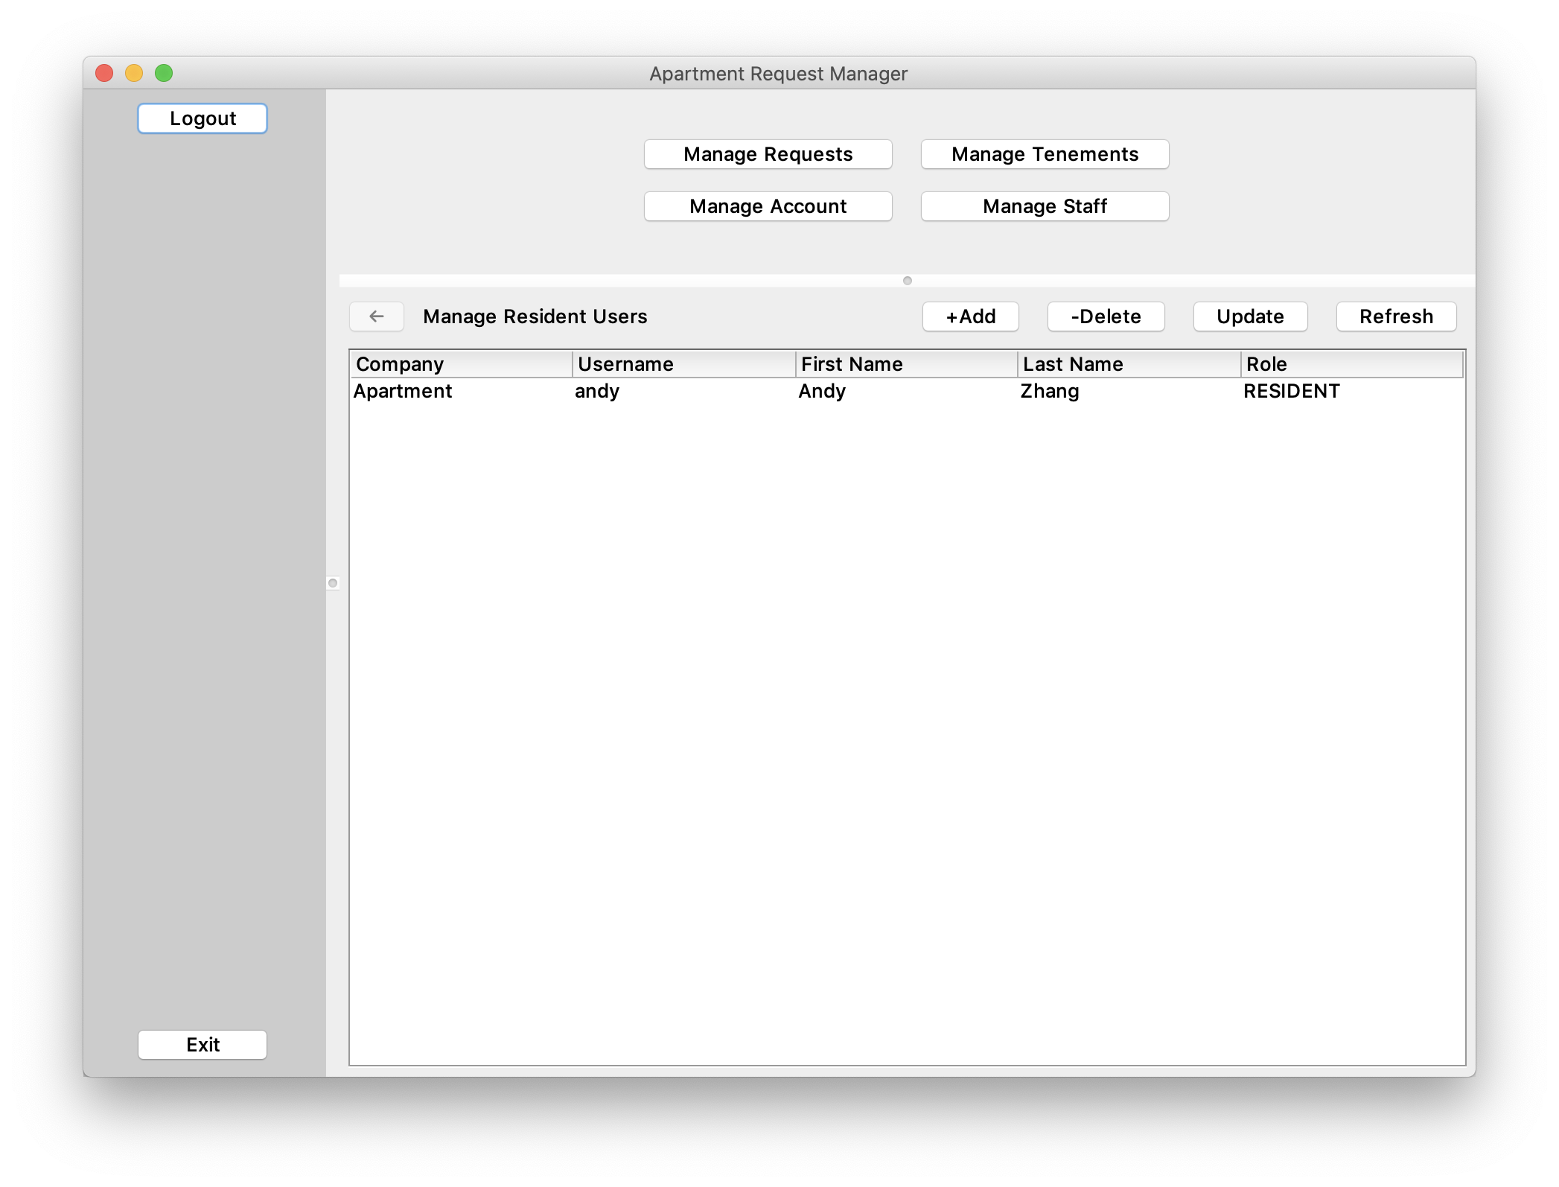
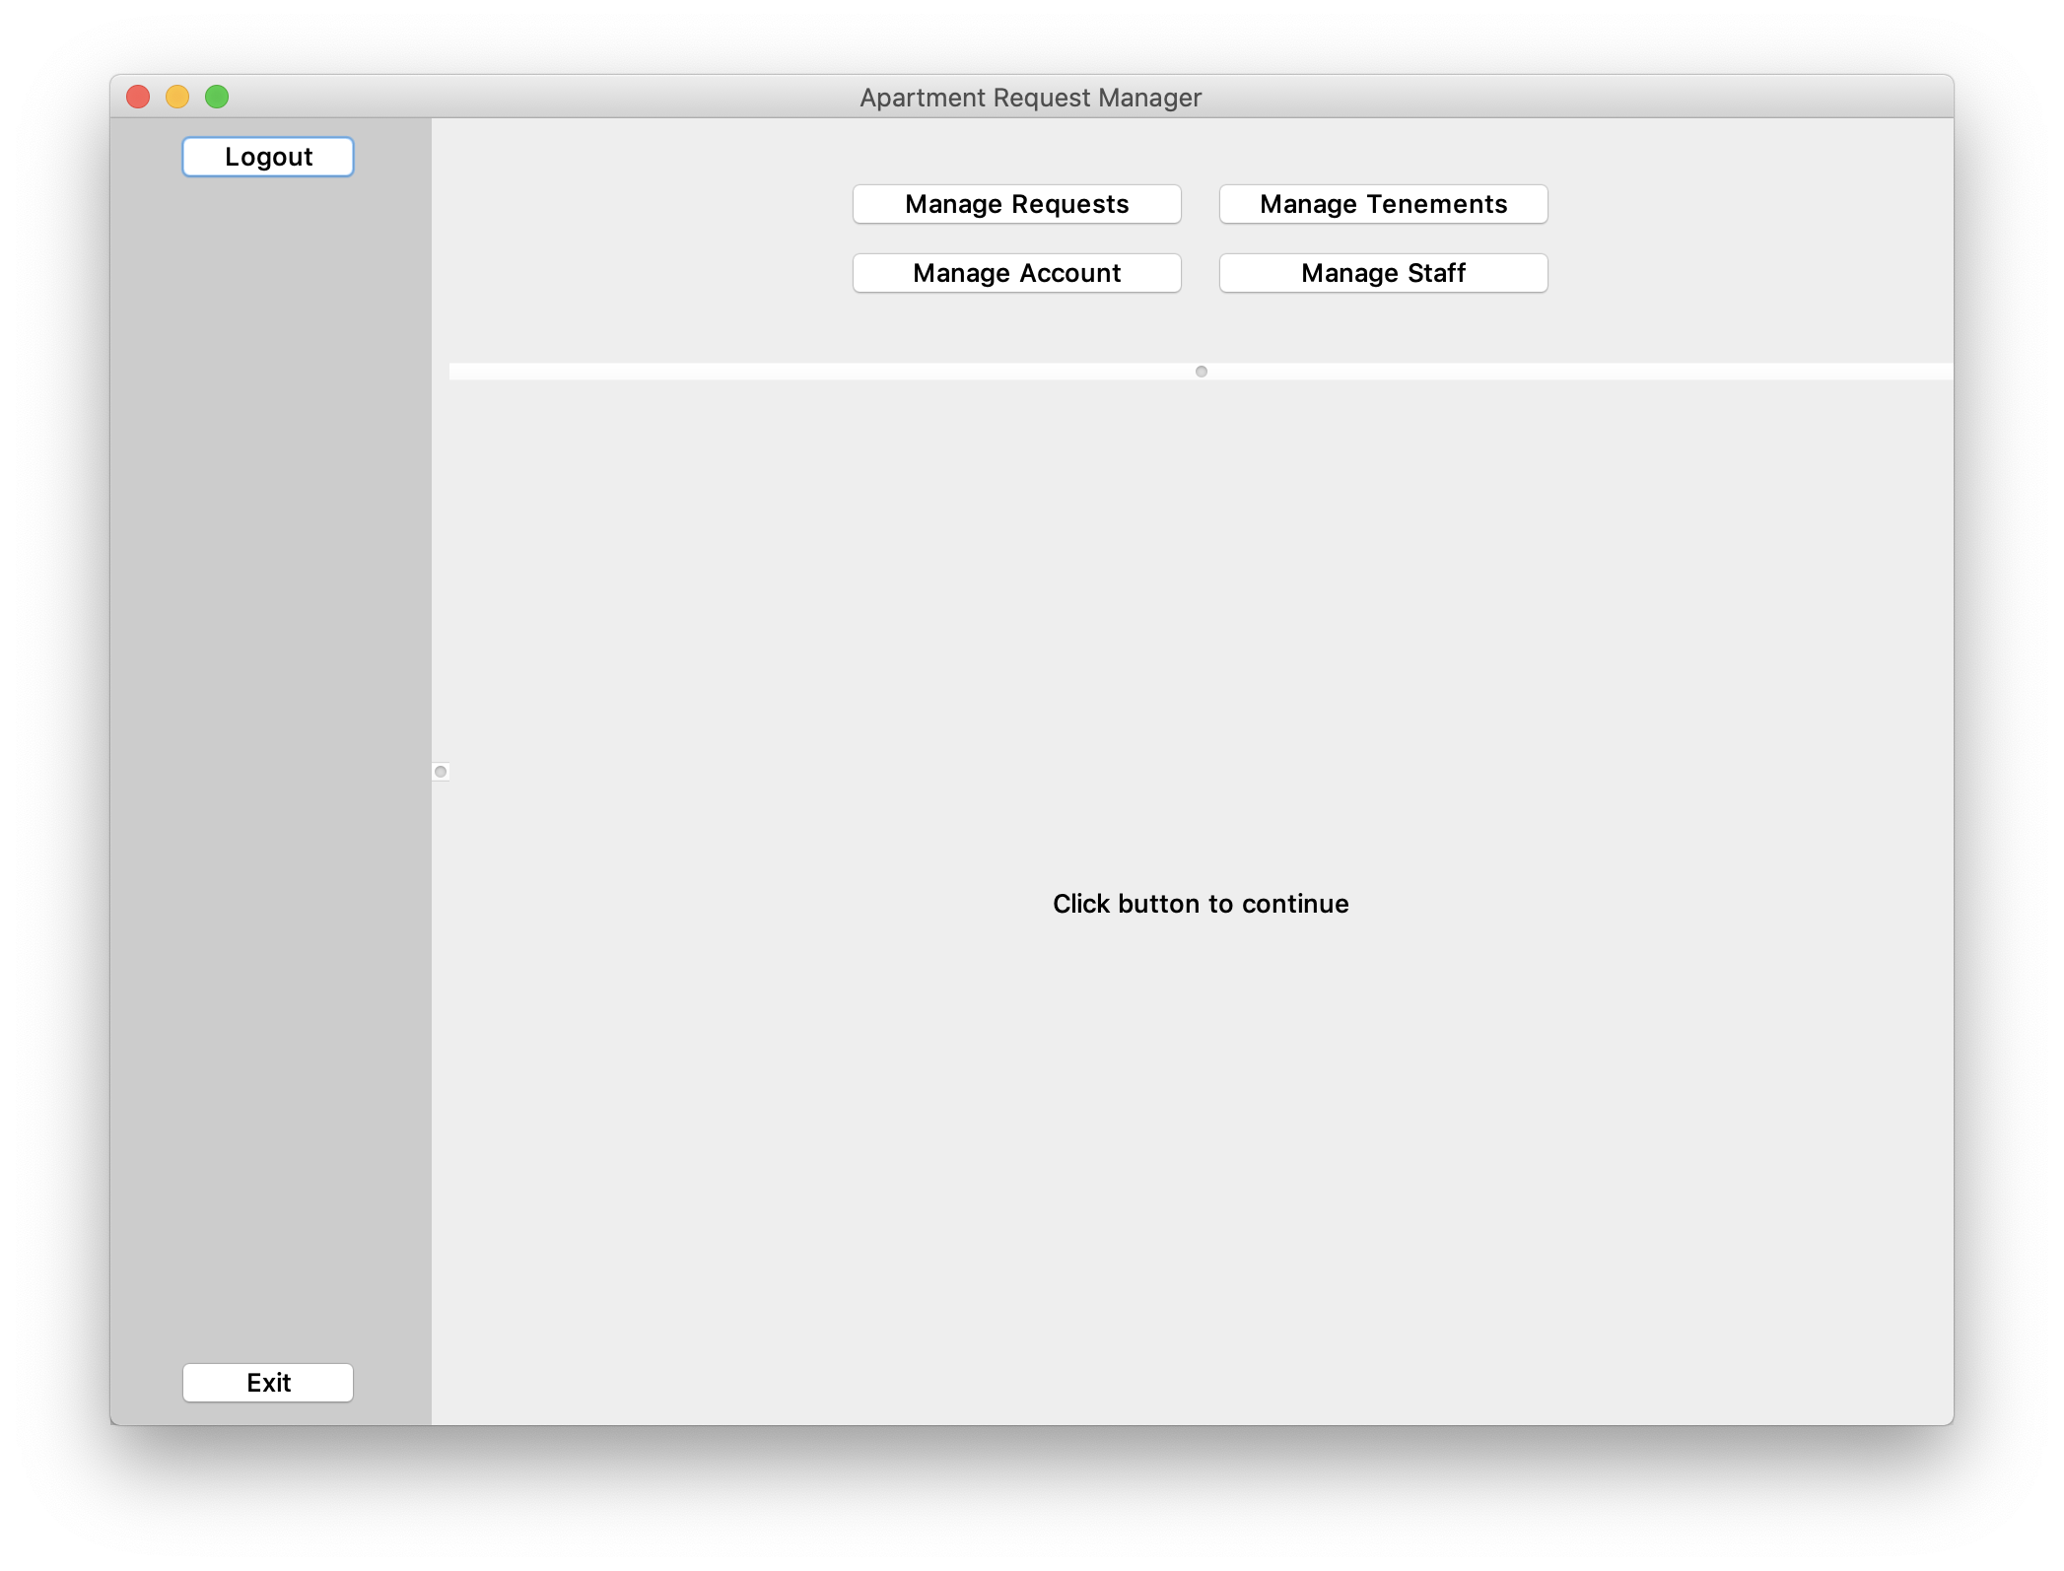
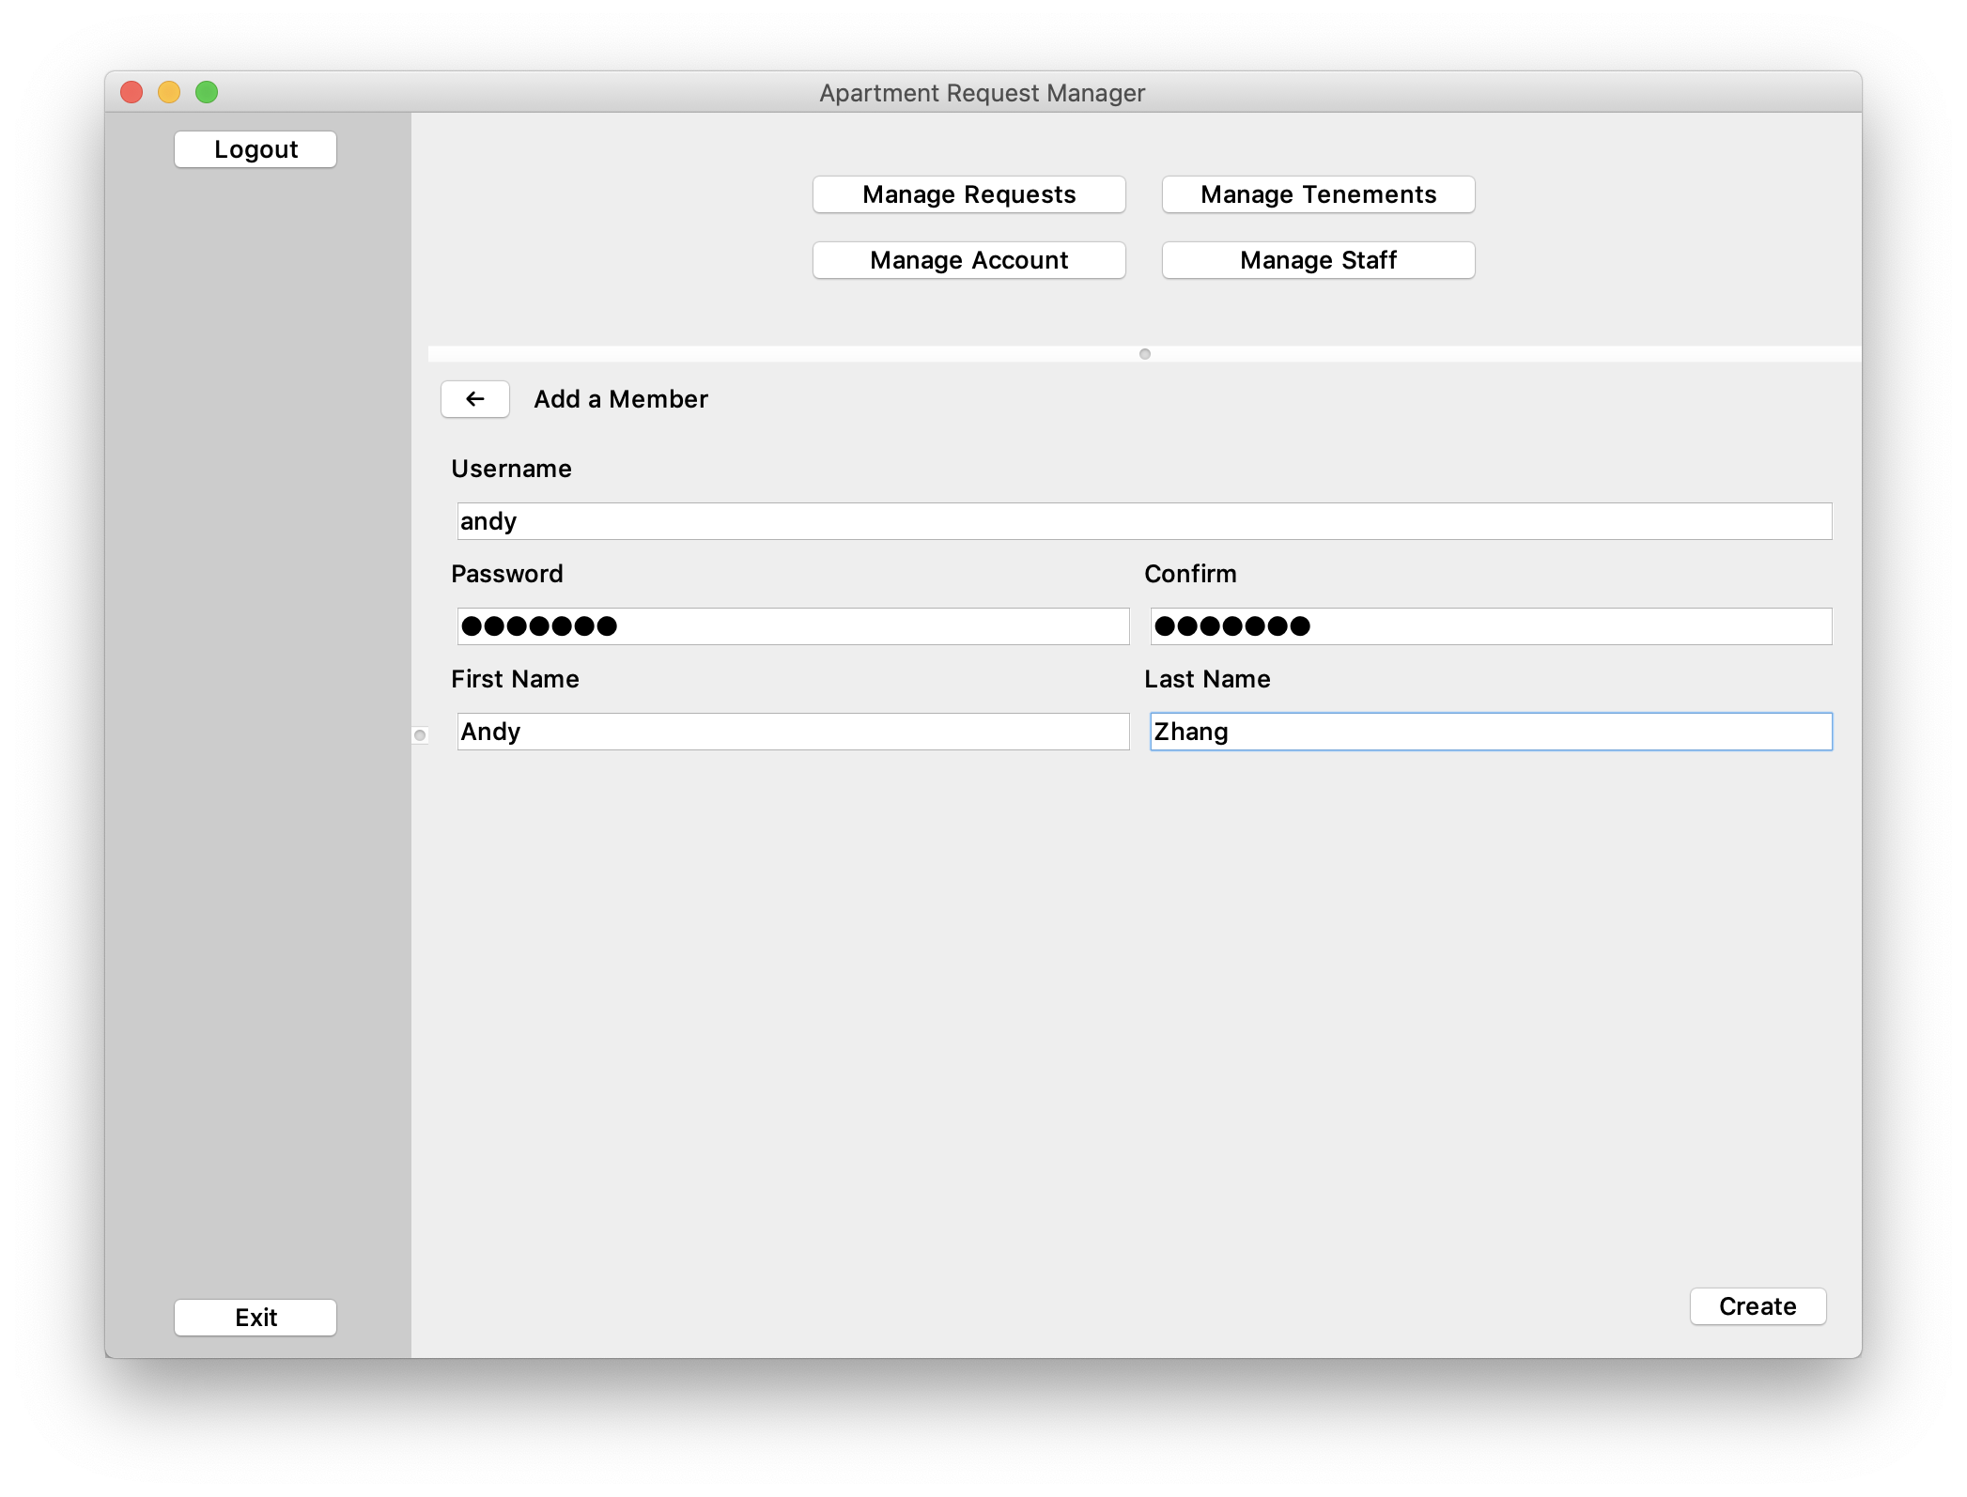
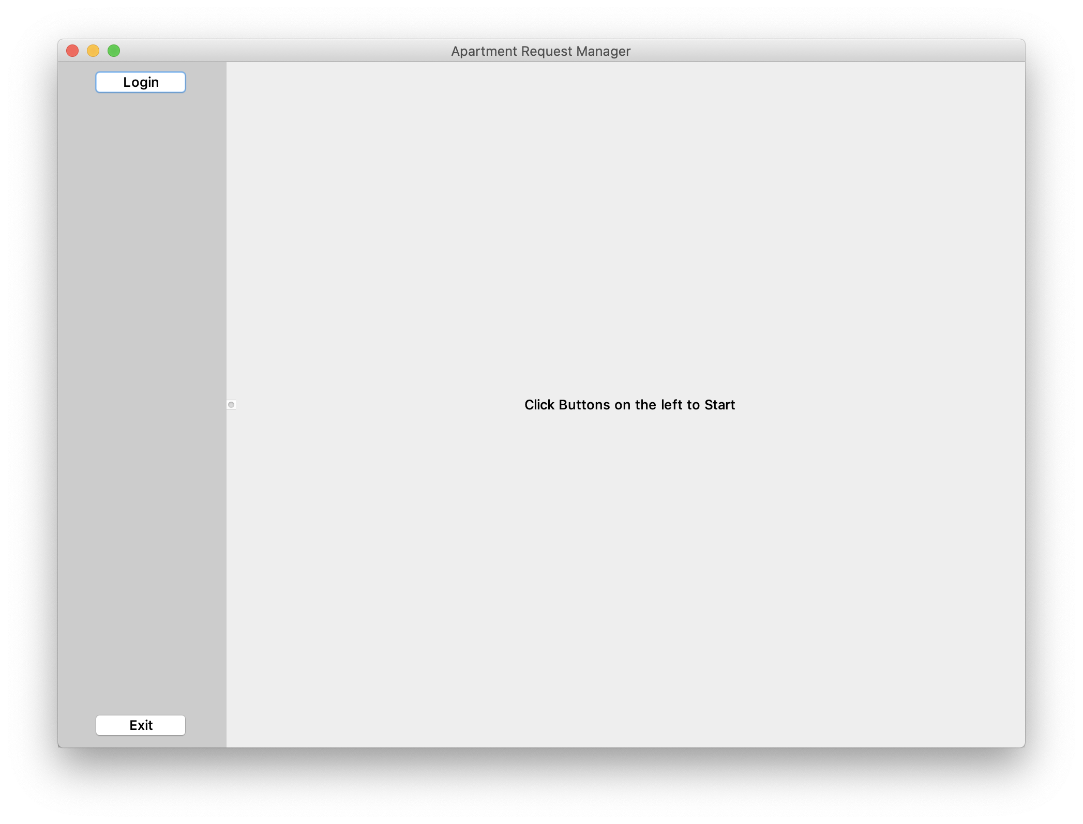
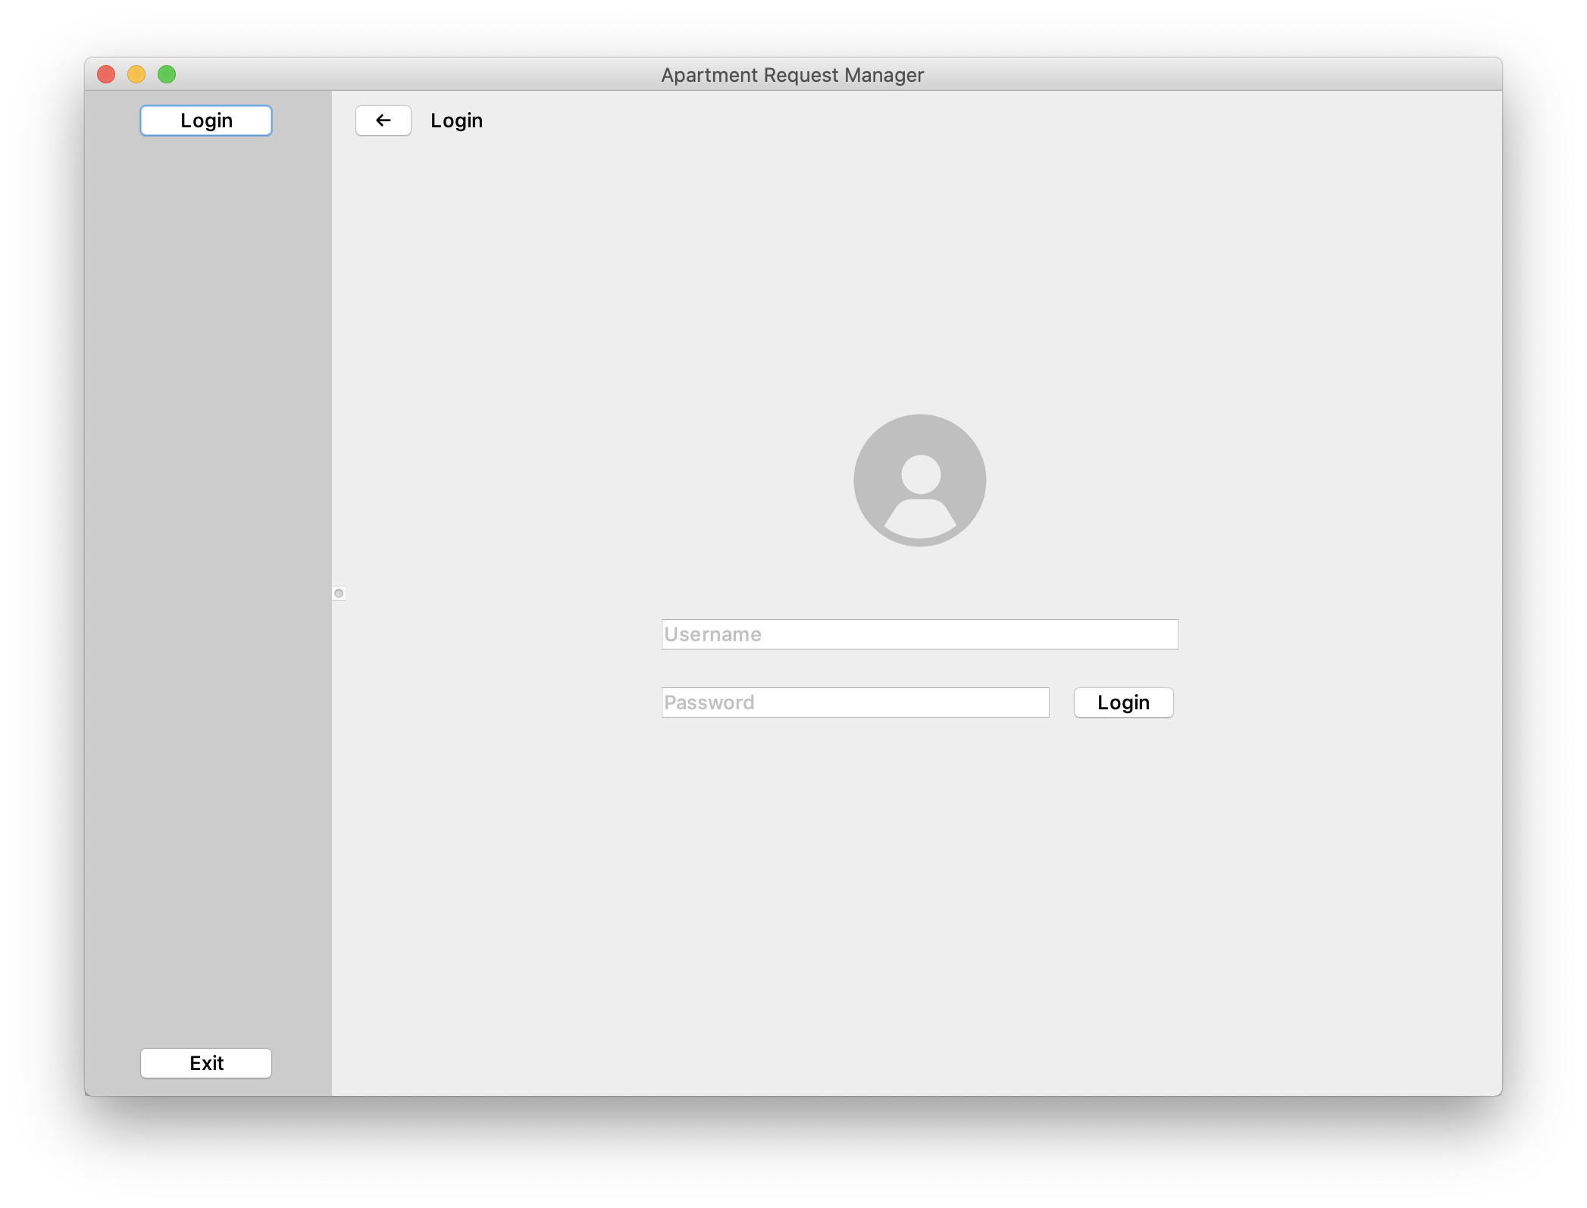
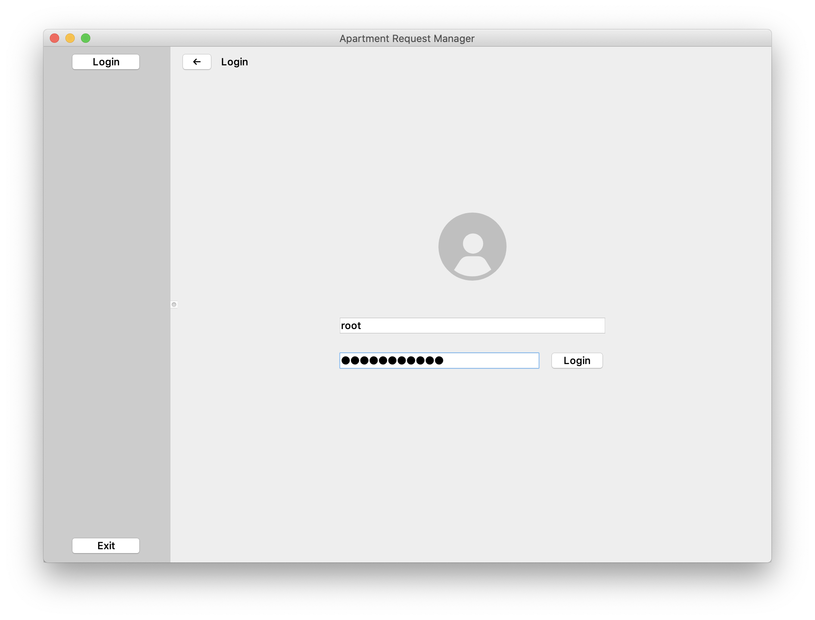
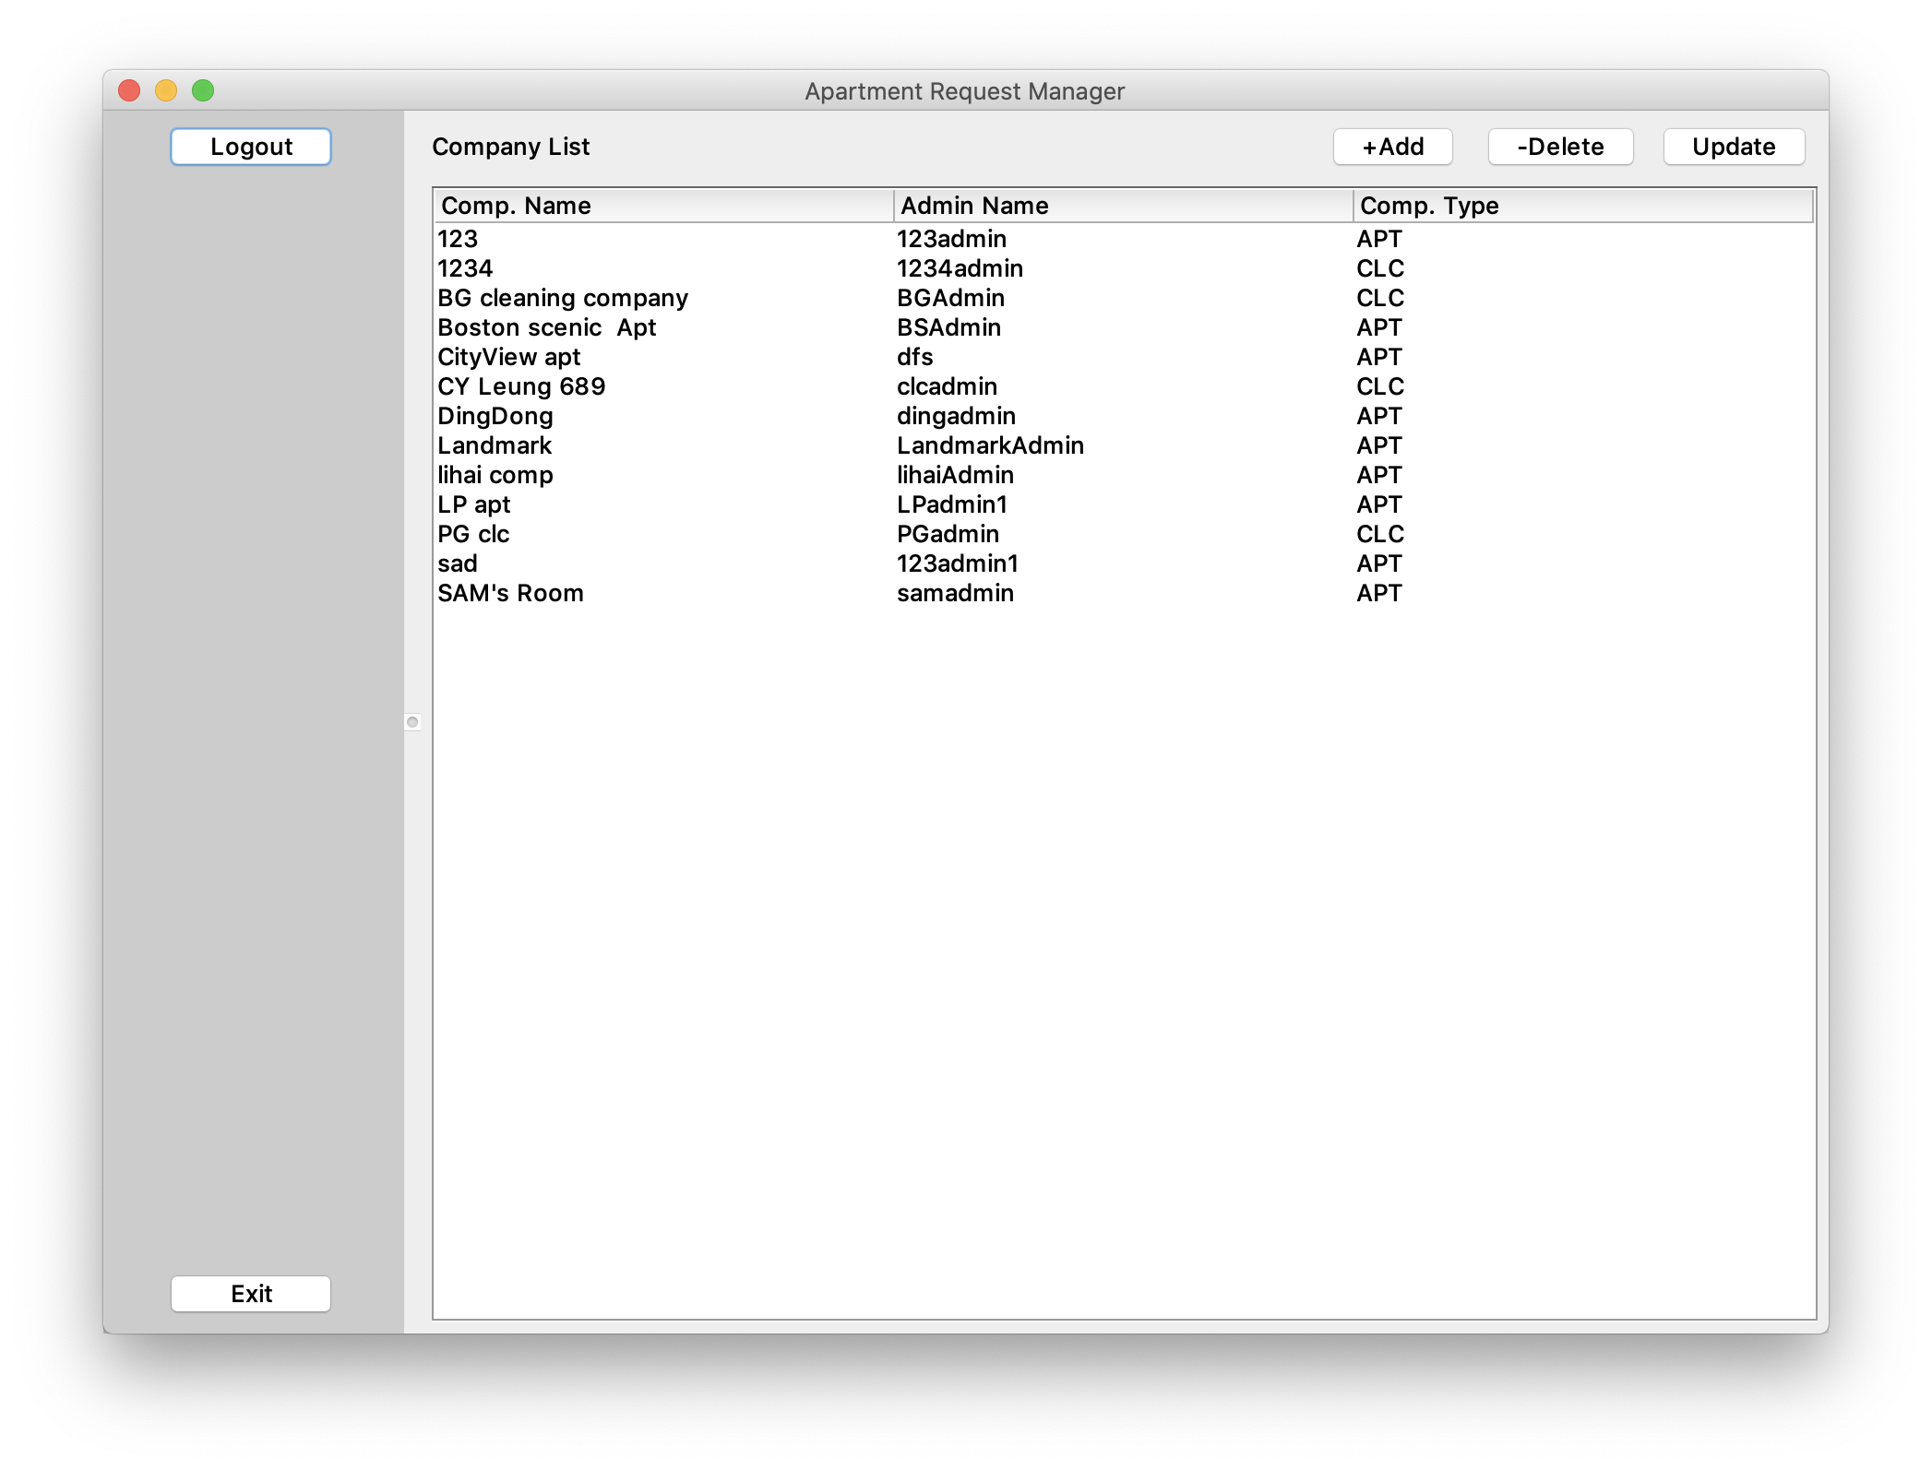
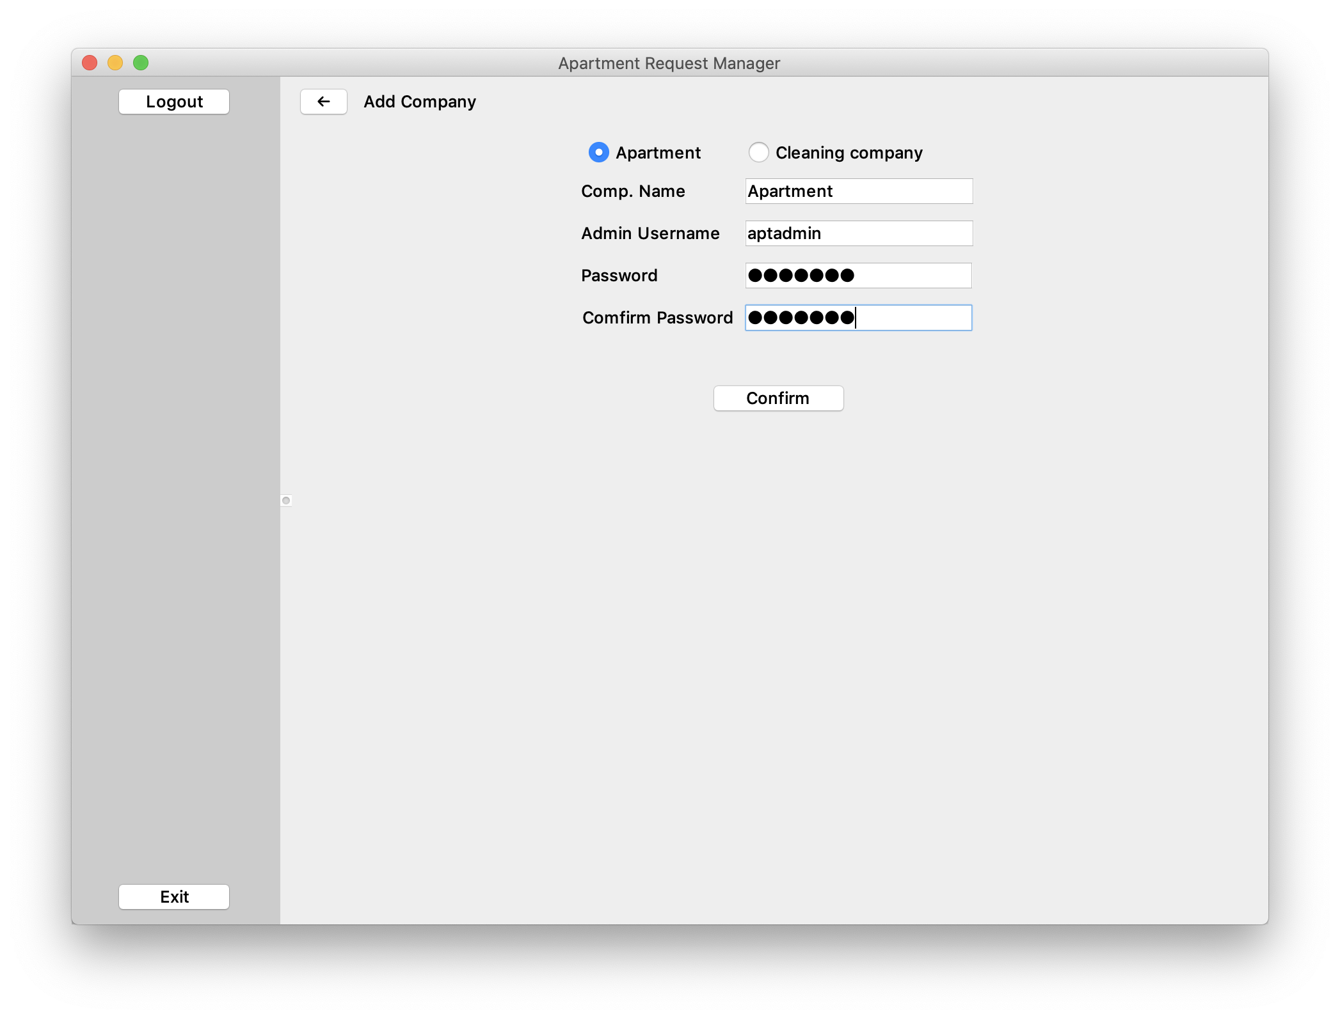

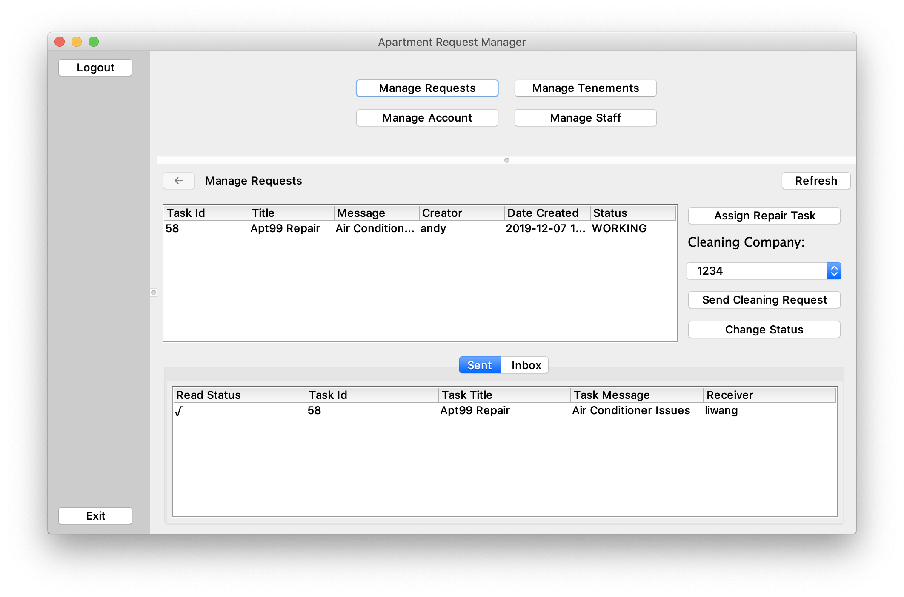
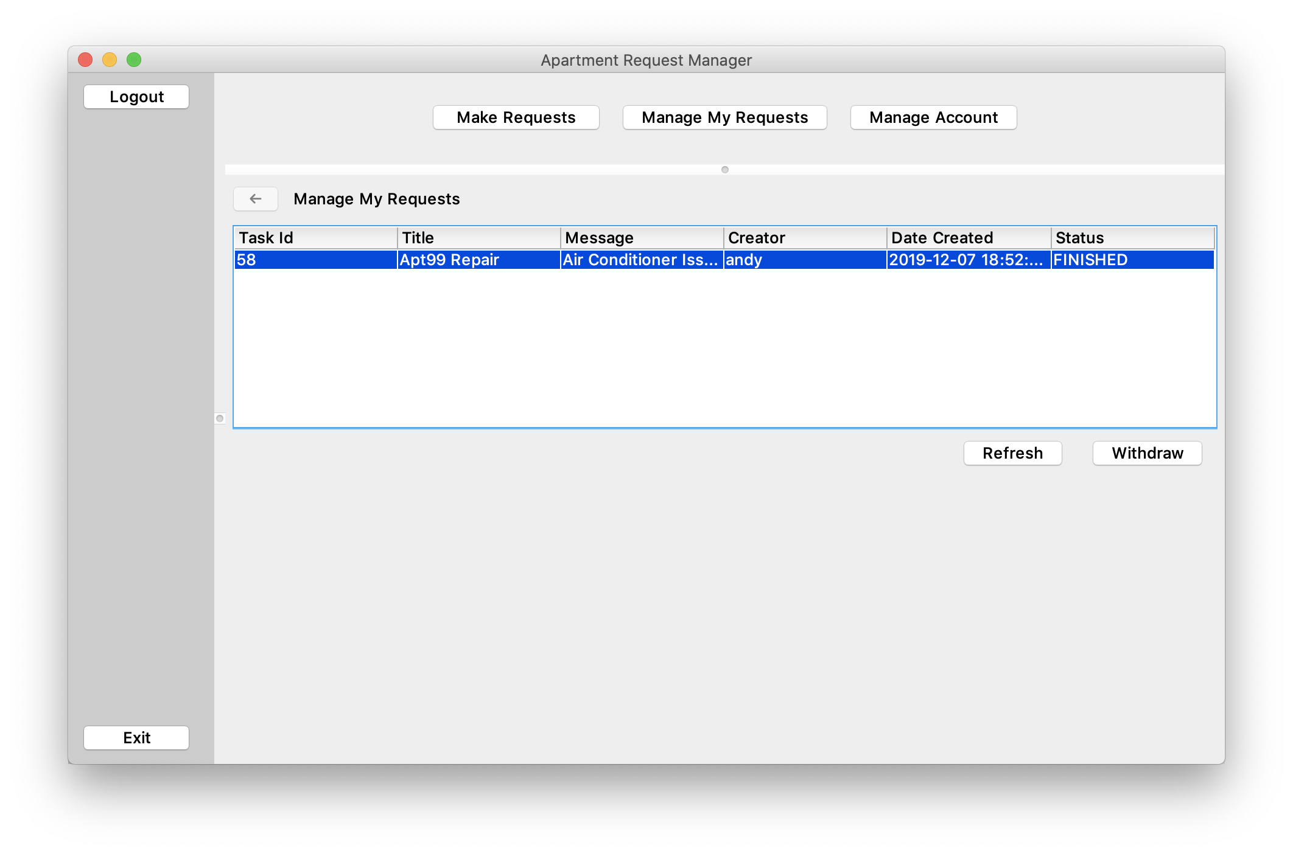
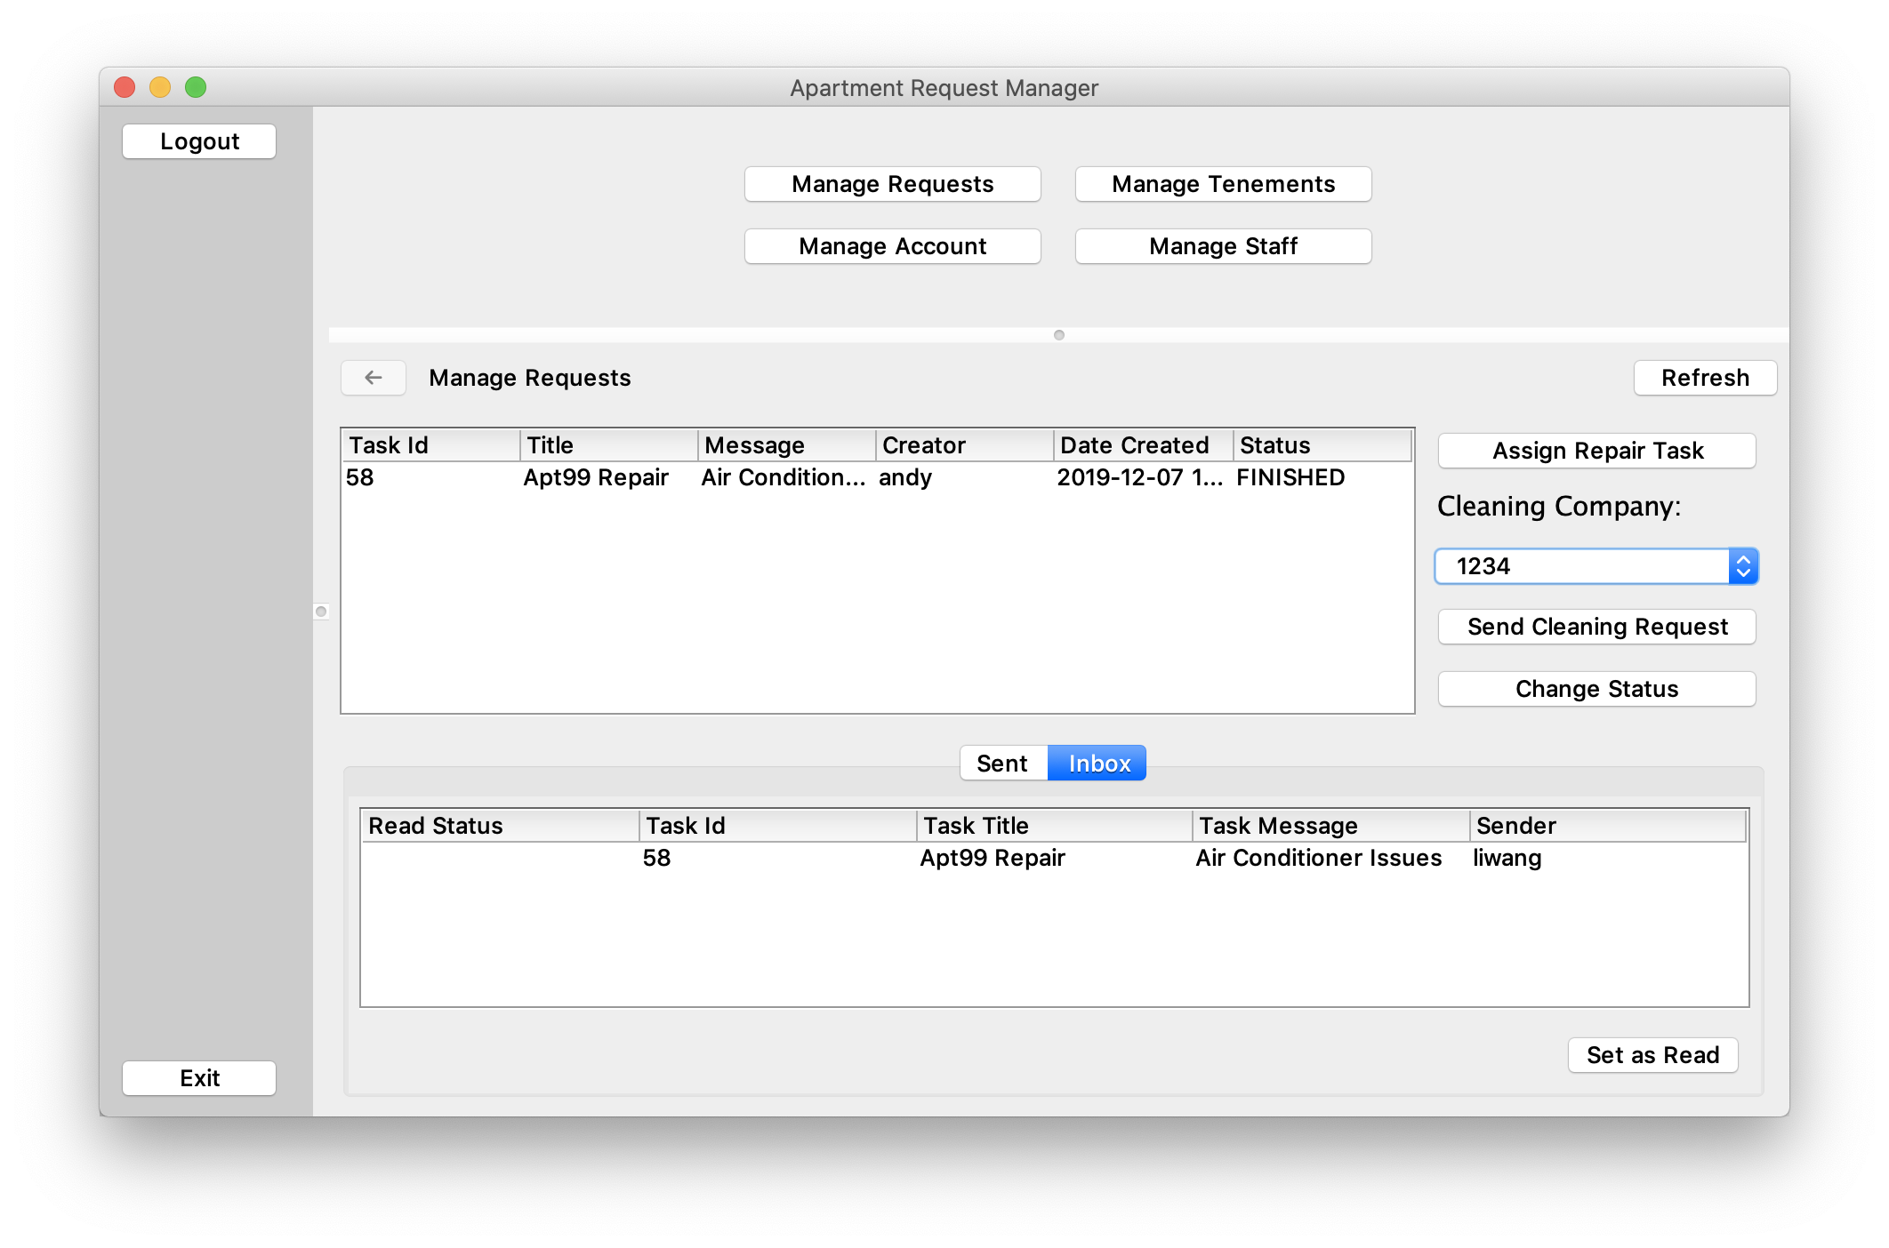
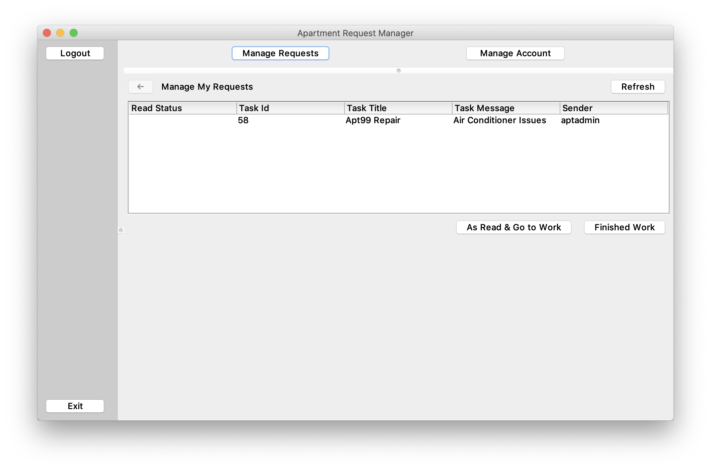
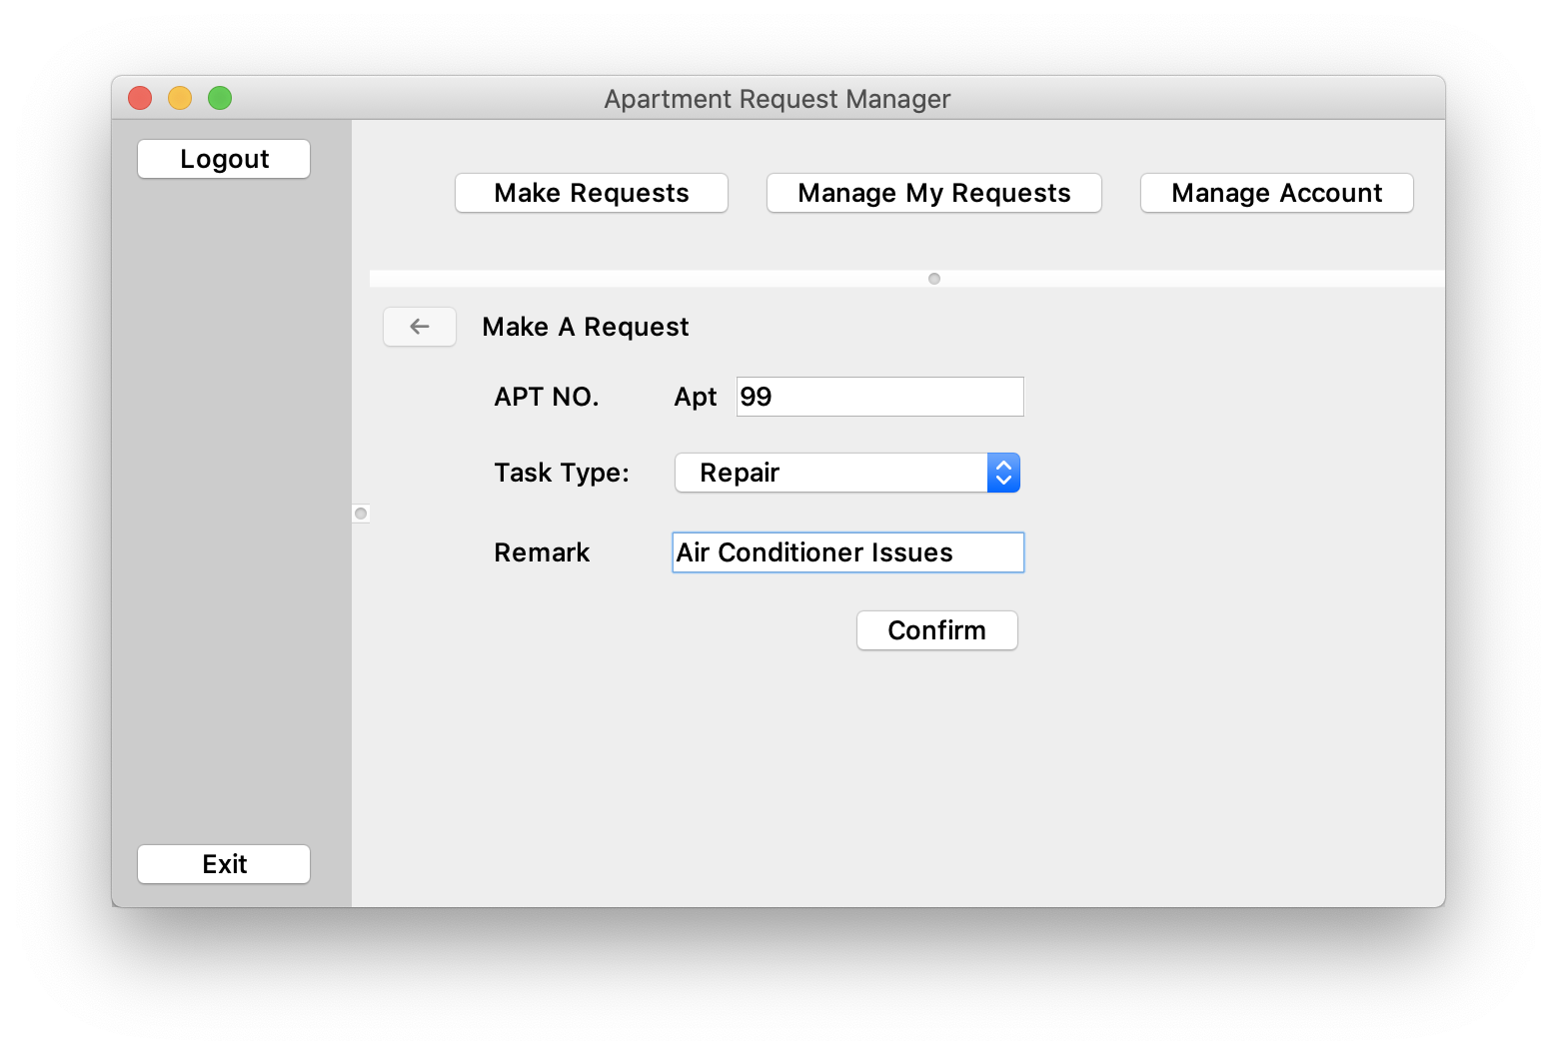
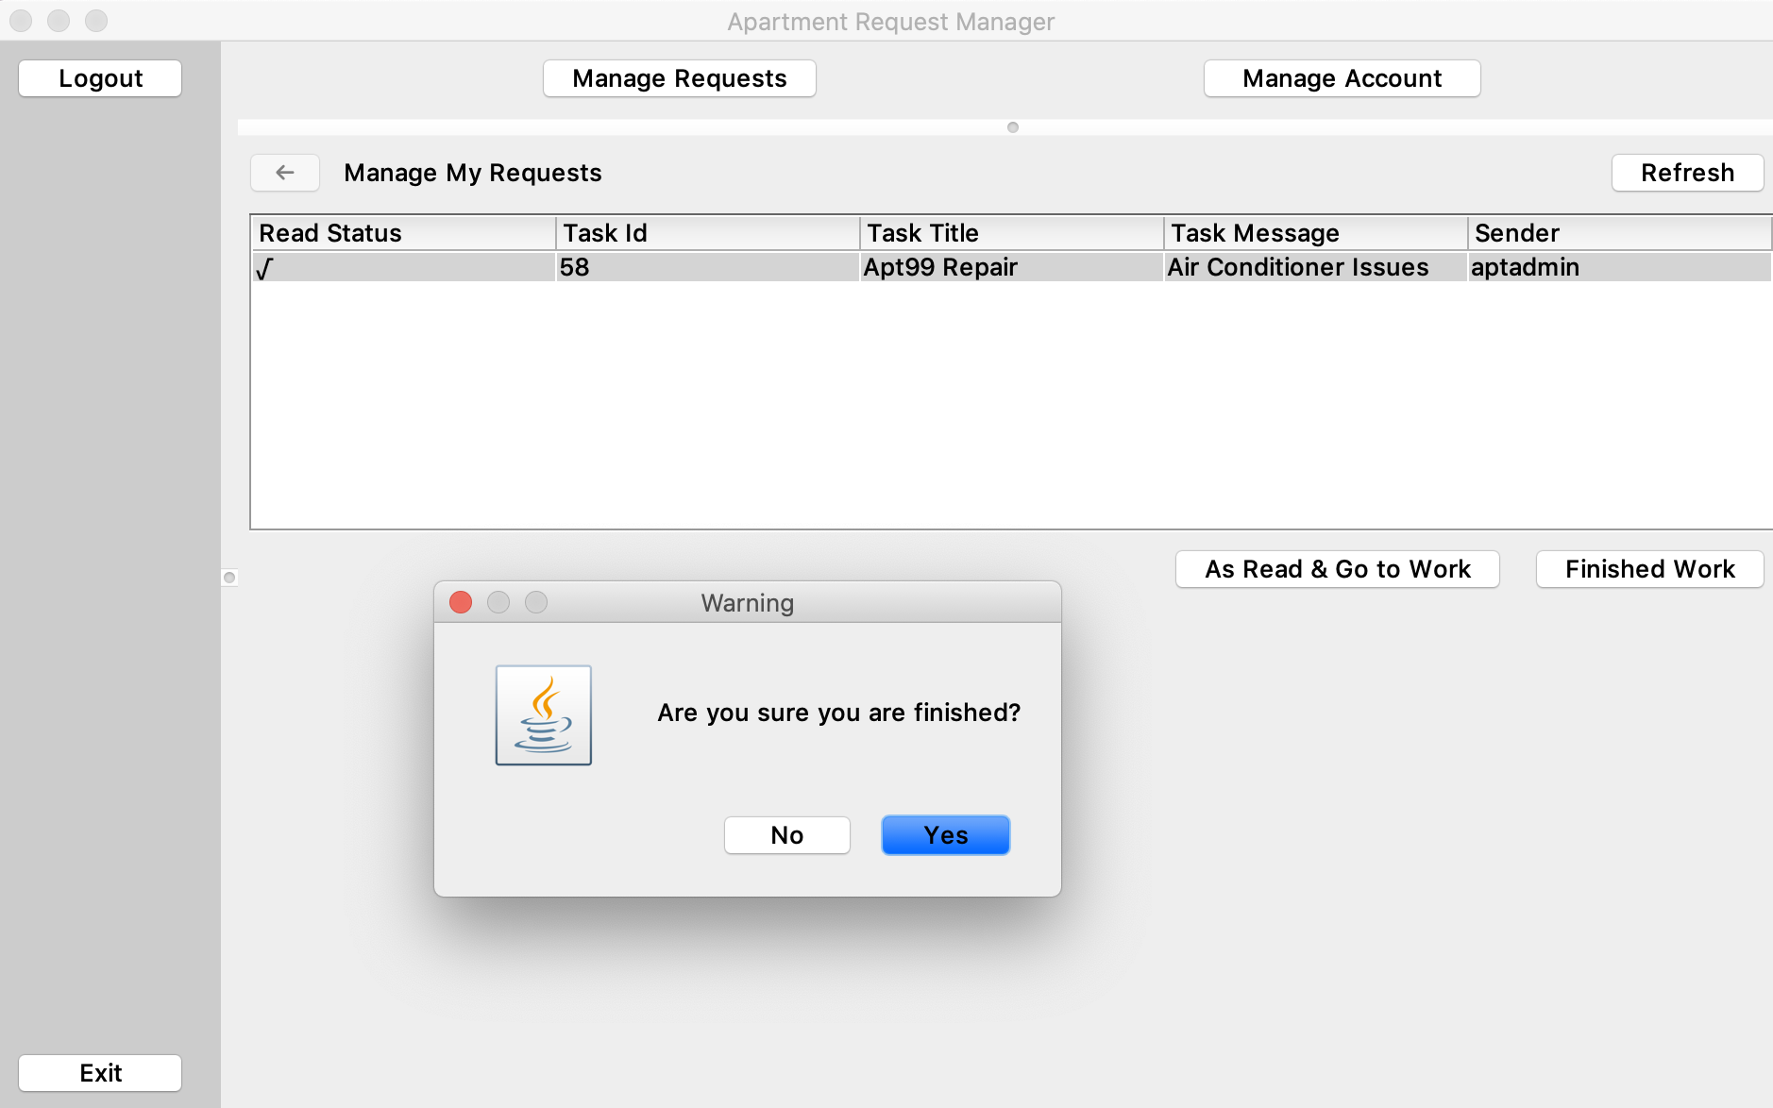
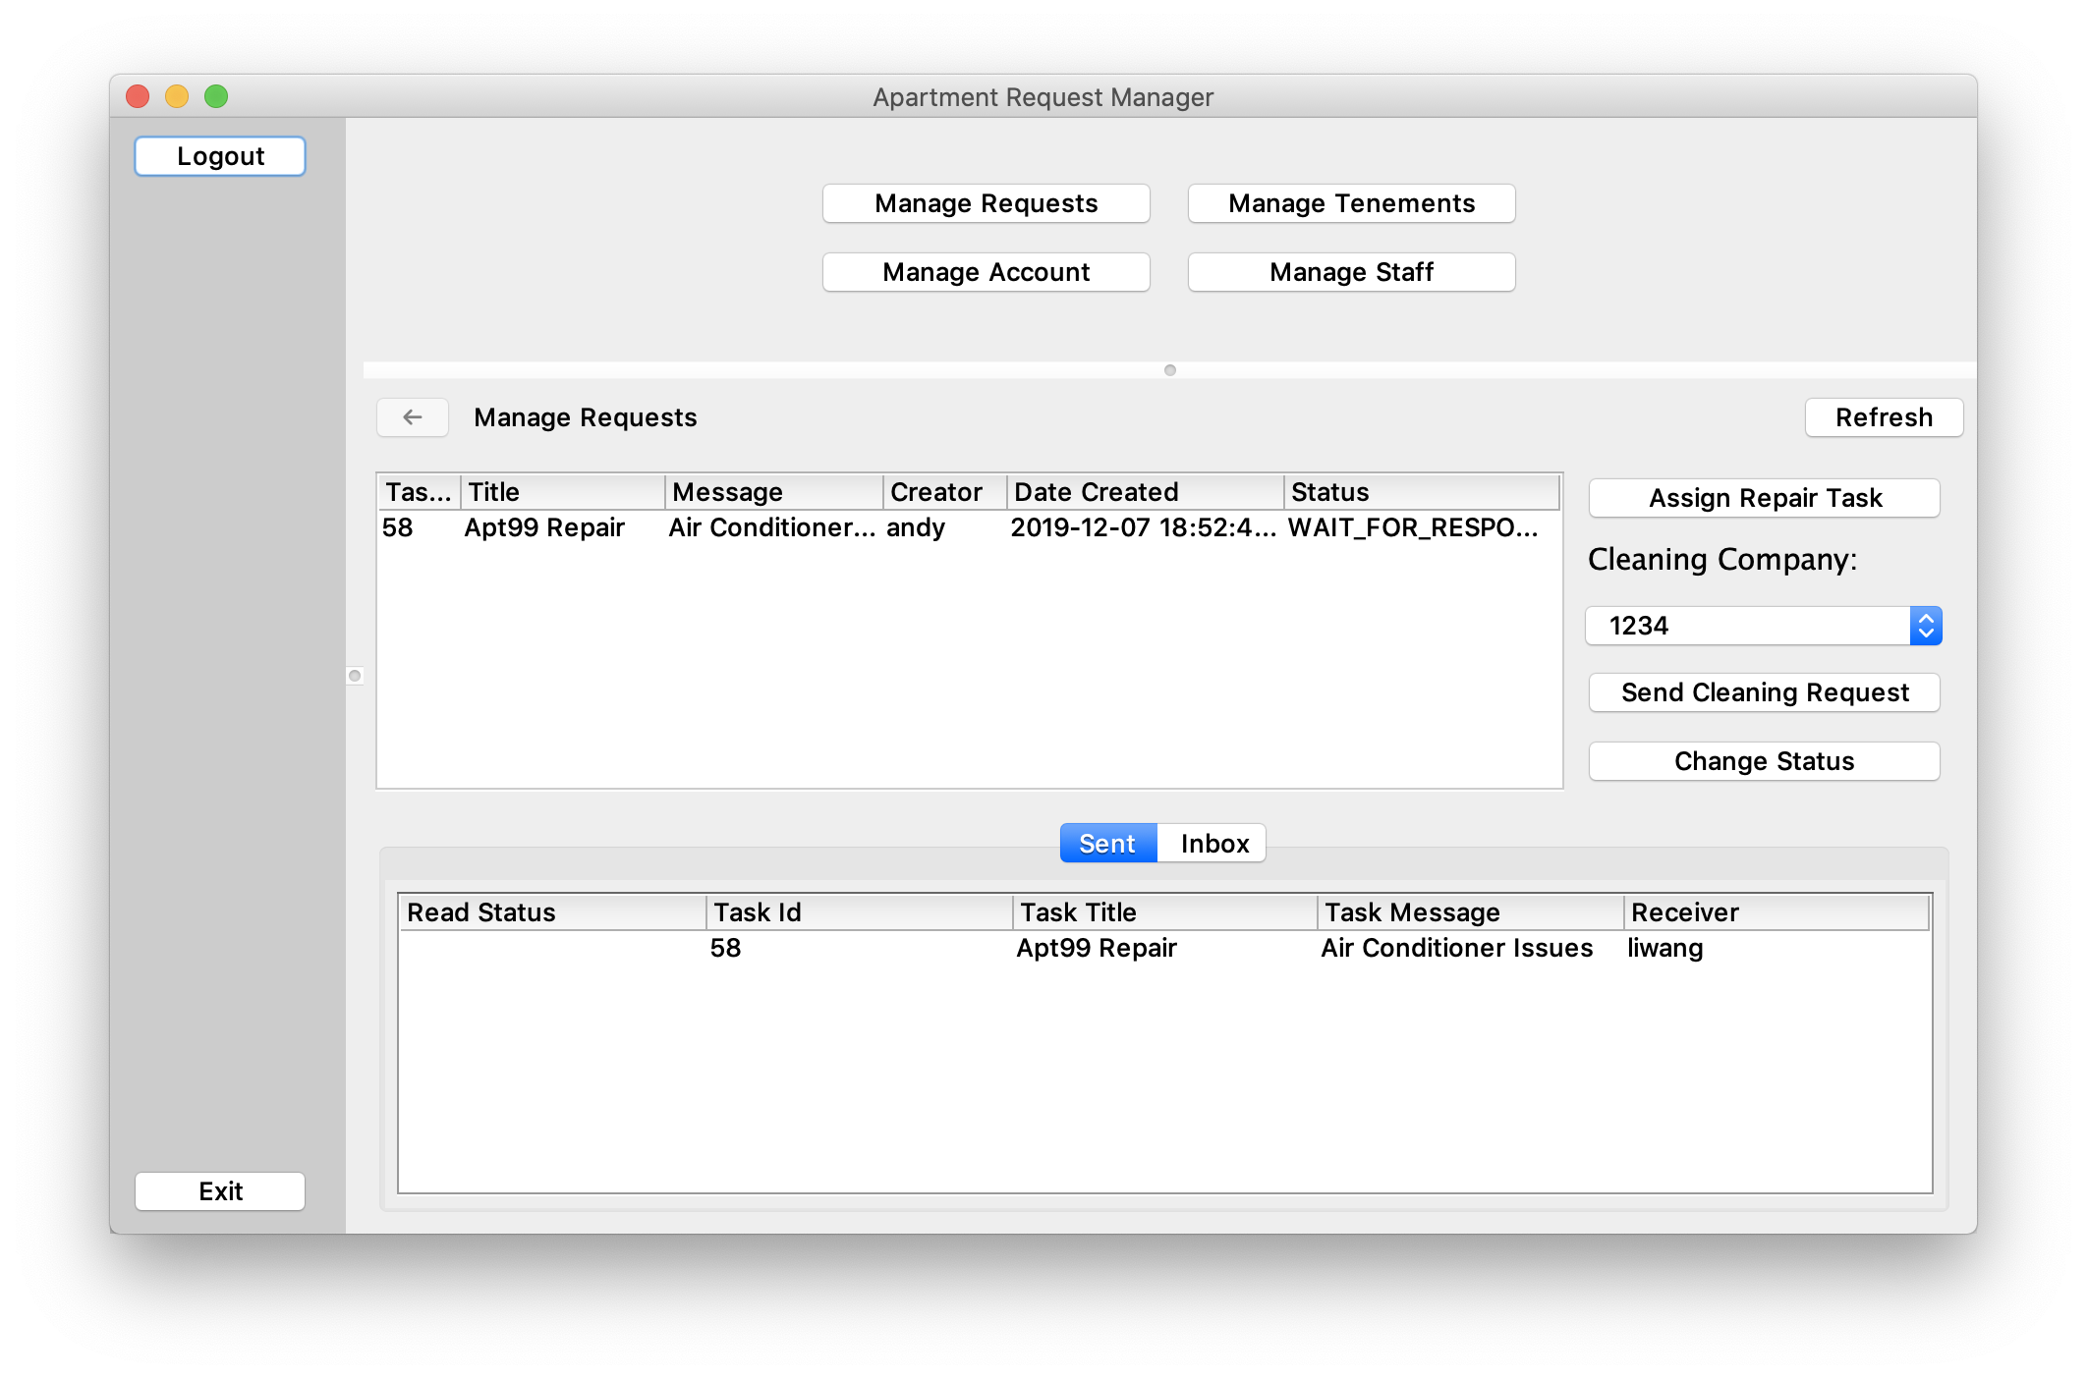
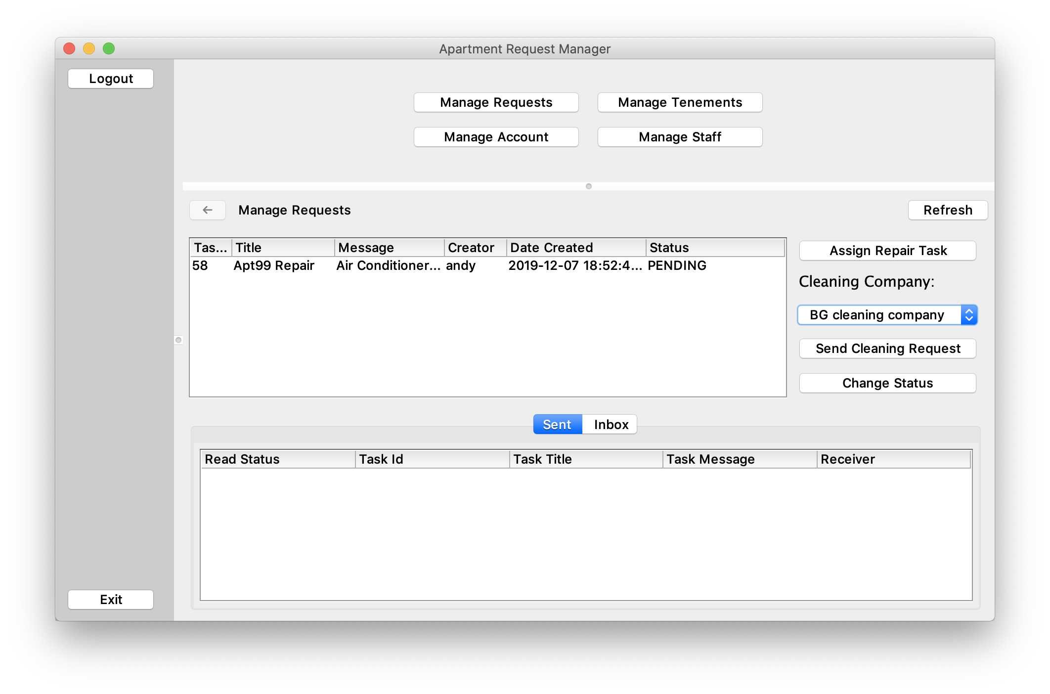
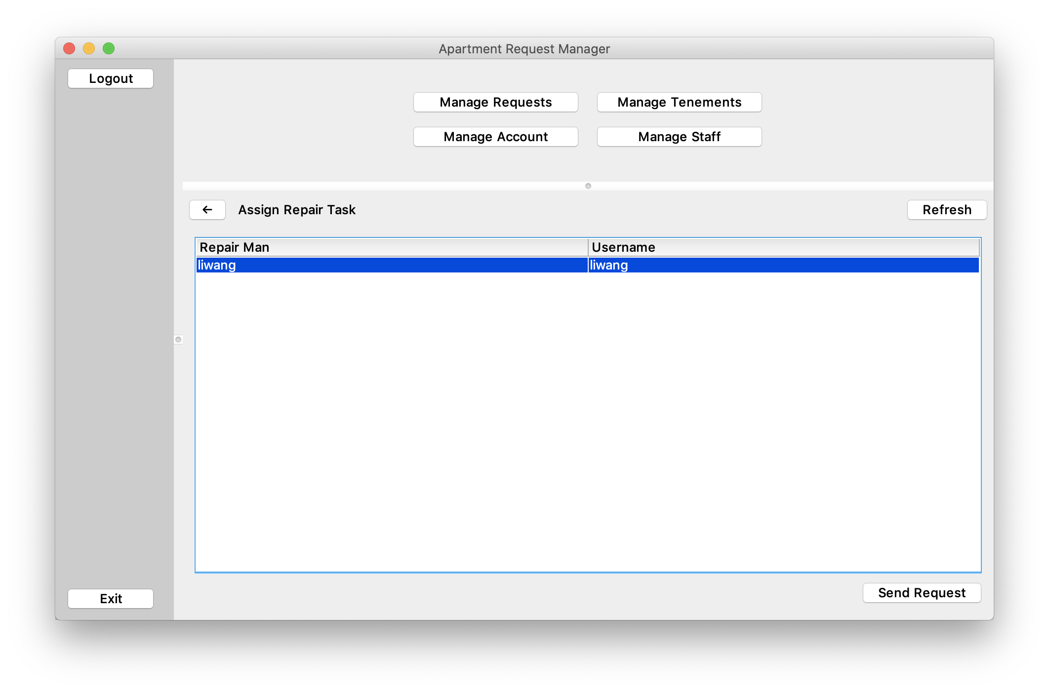
Use case #Repair Request
Company LOGO

Slide 7
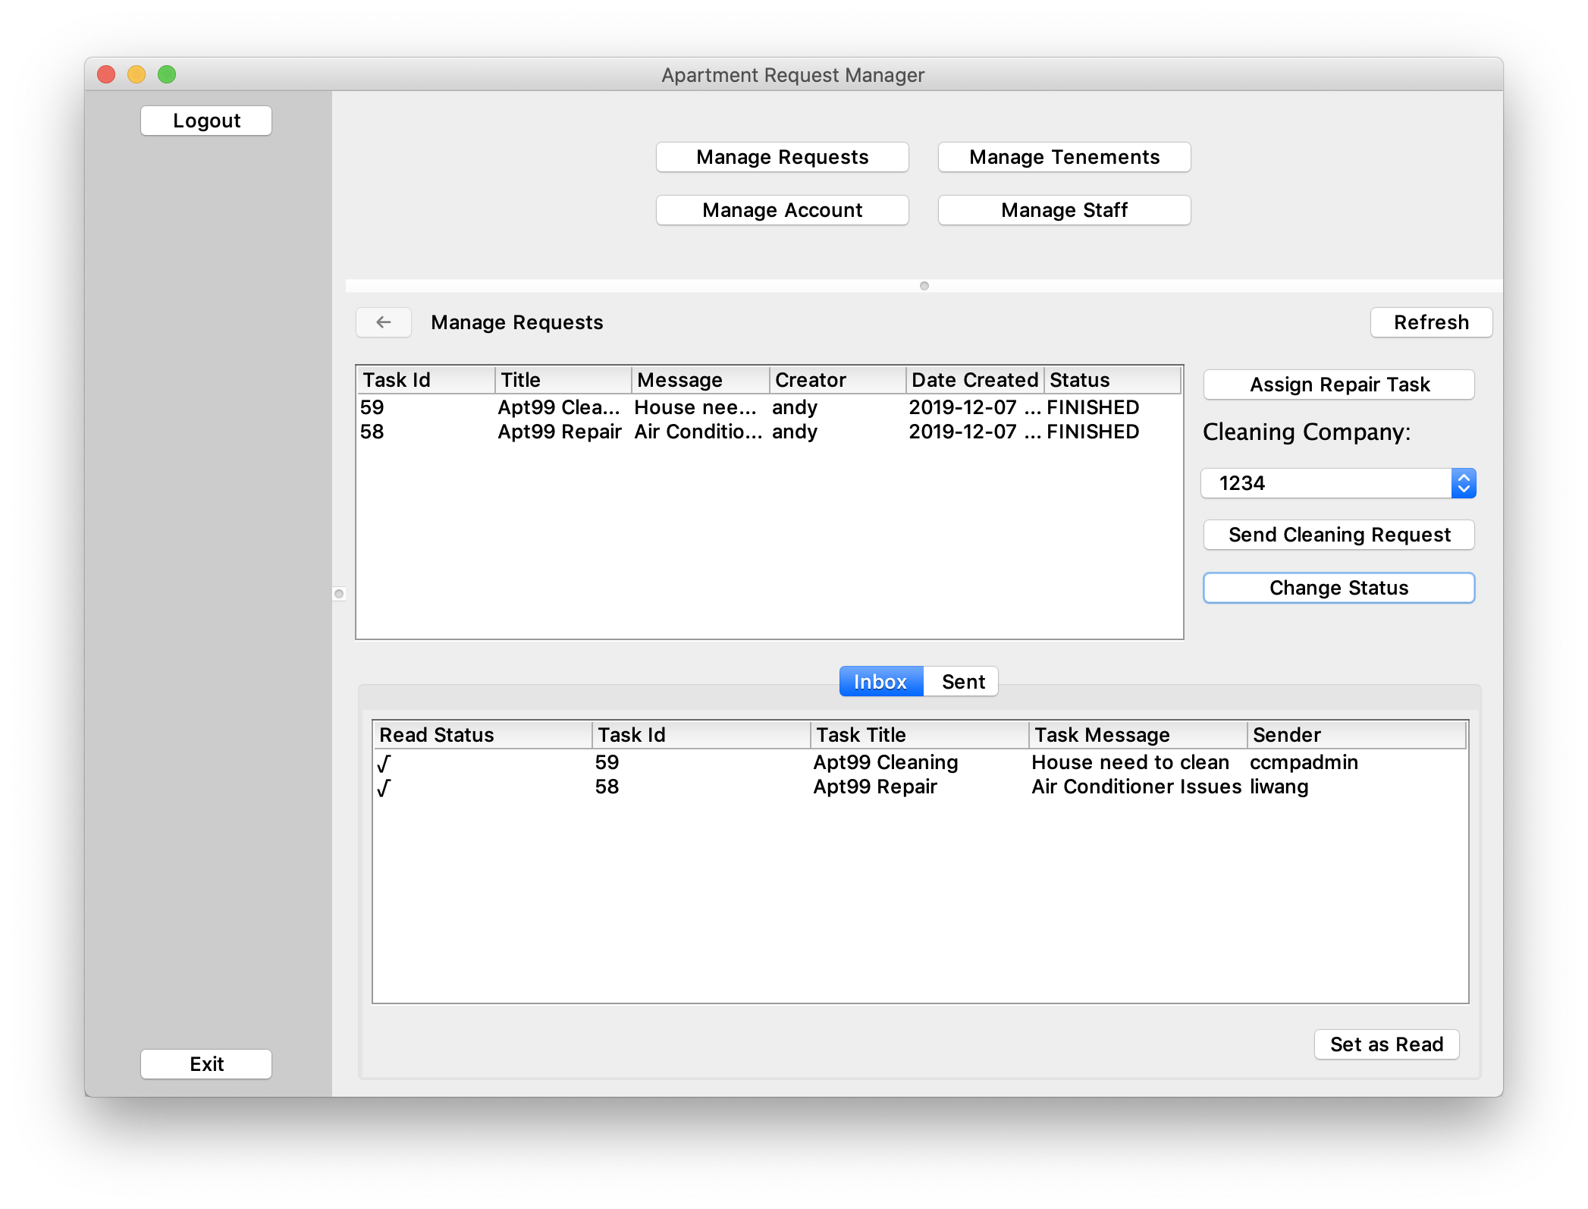
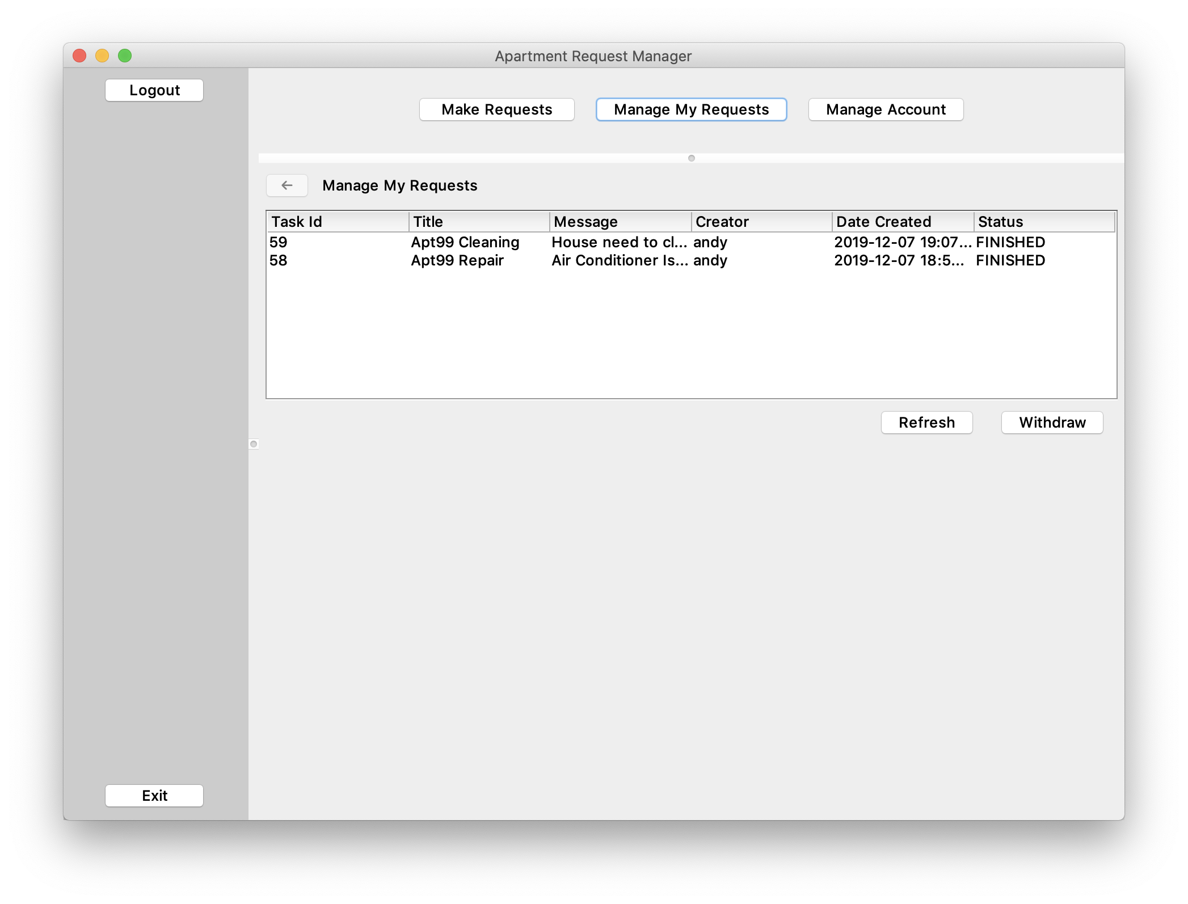
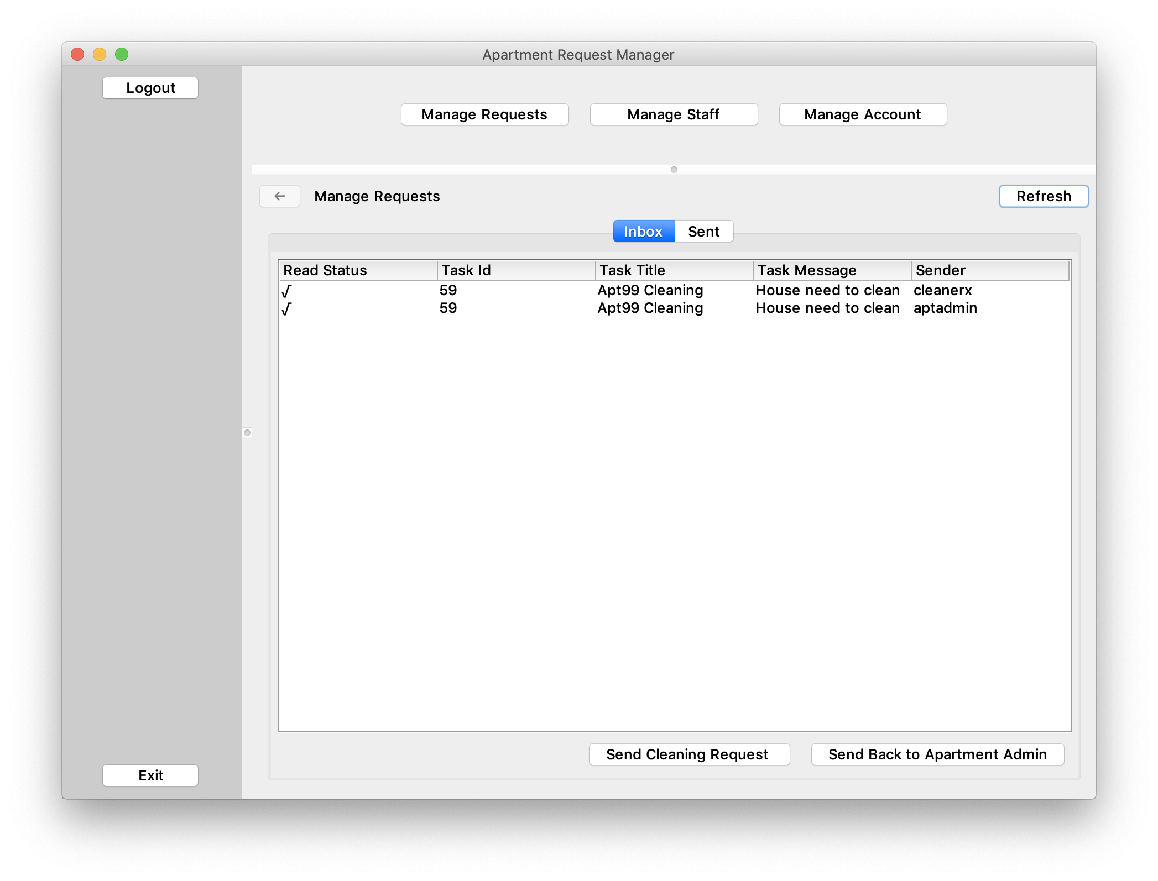
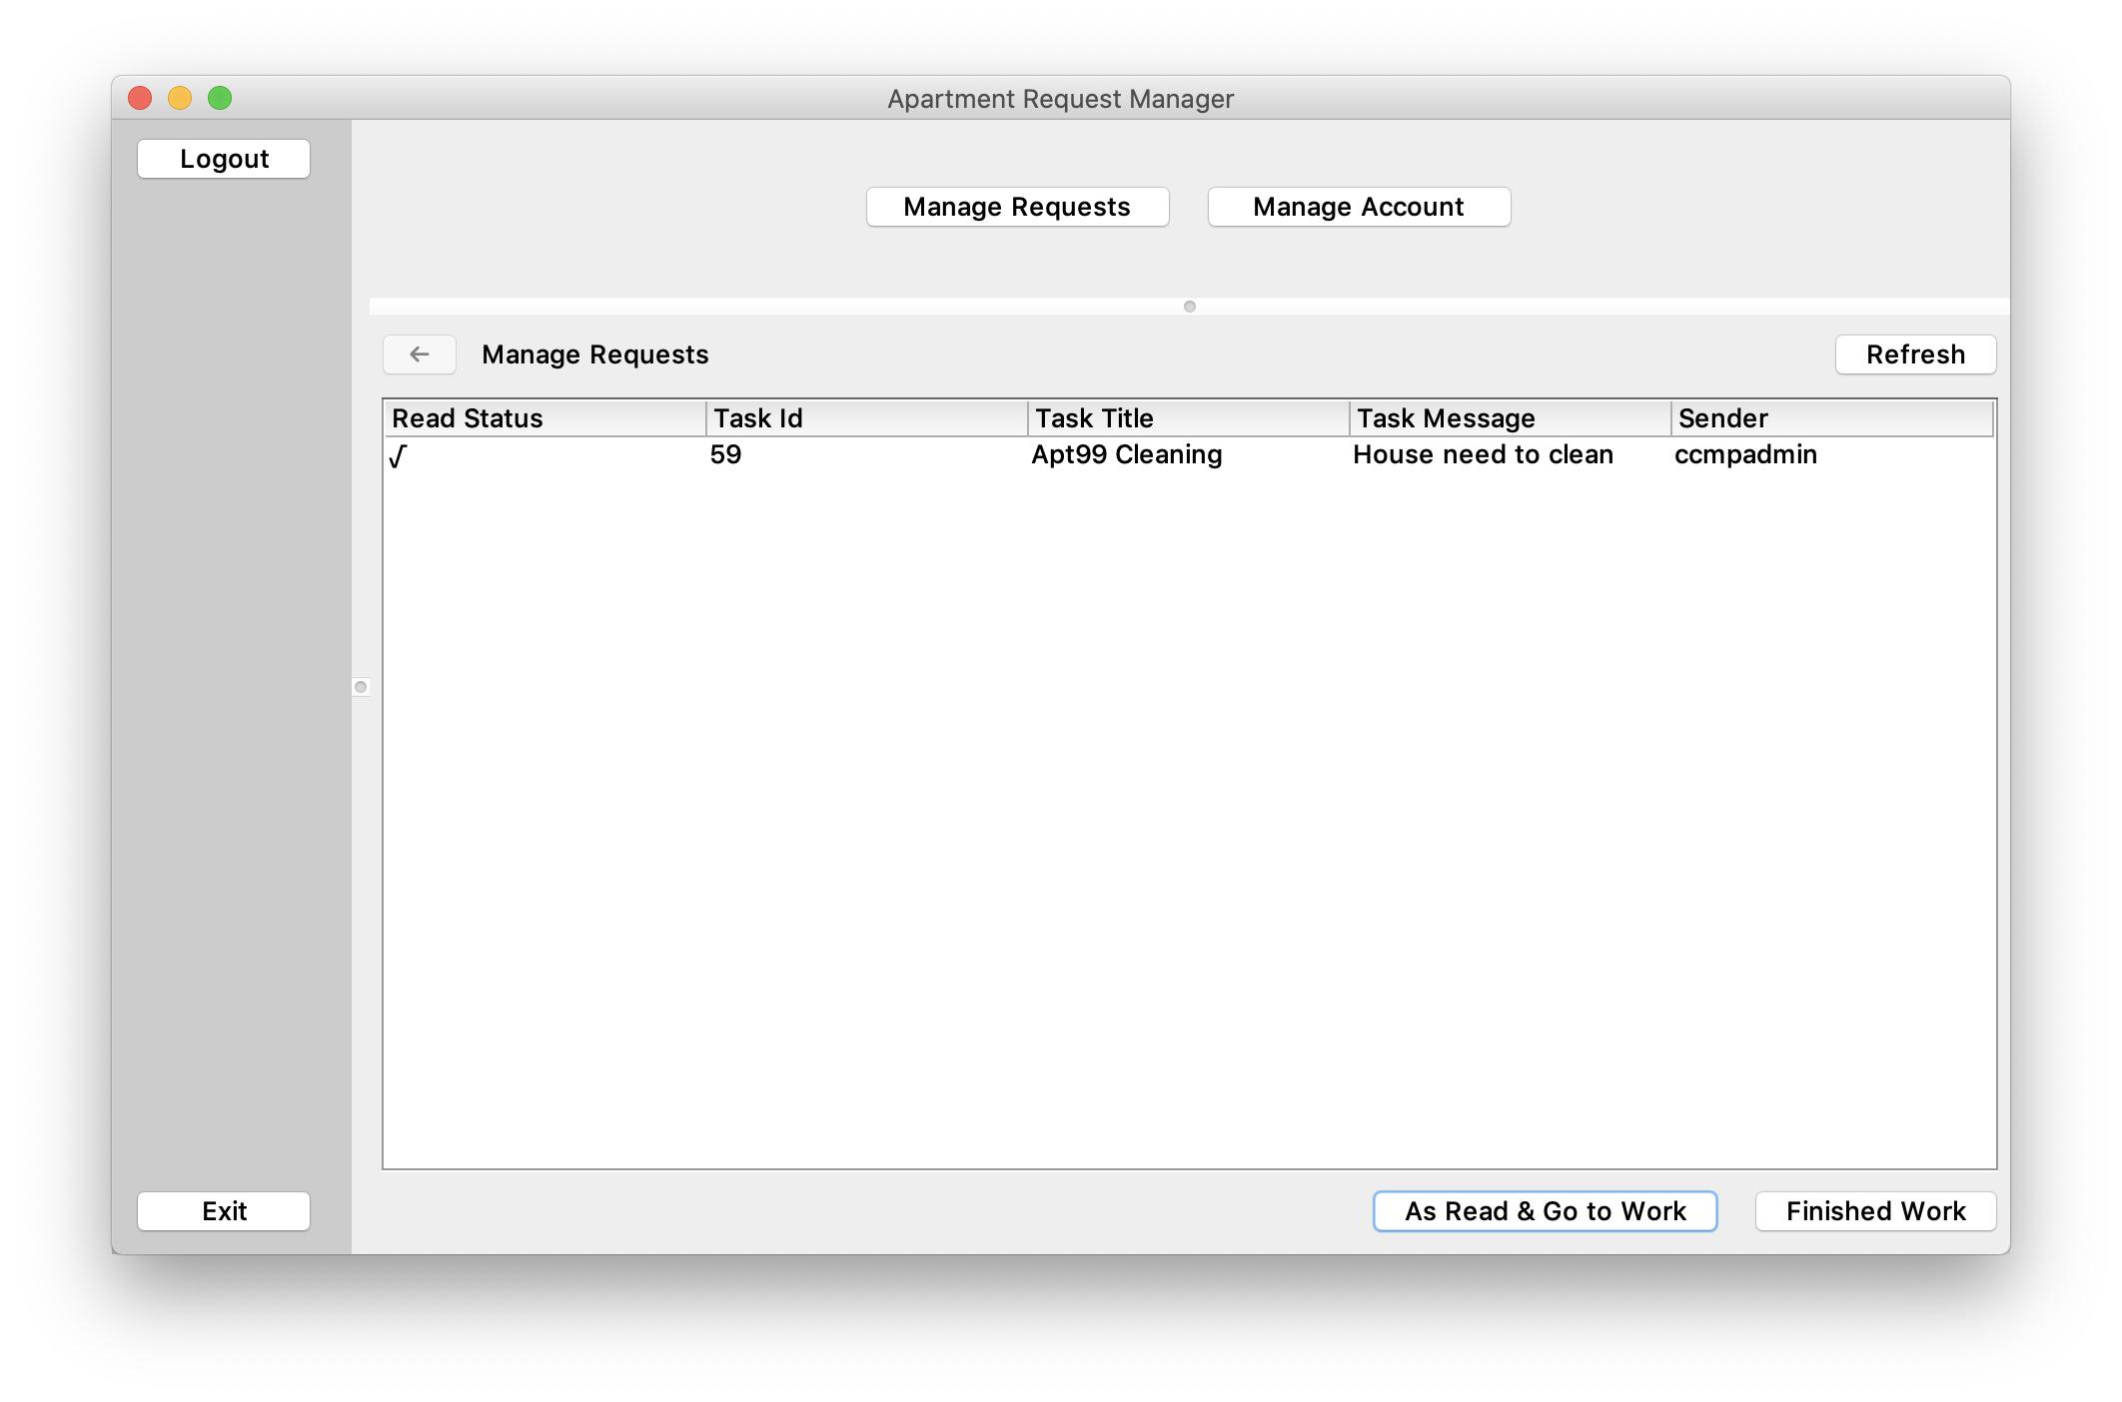
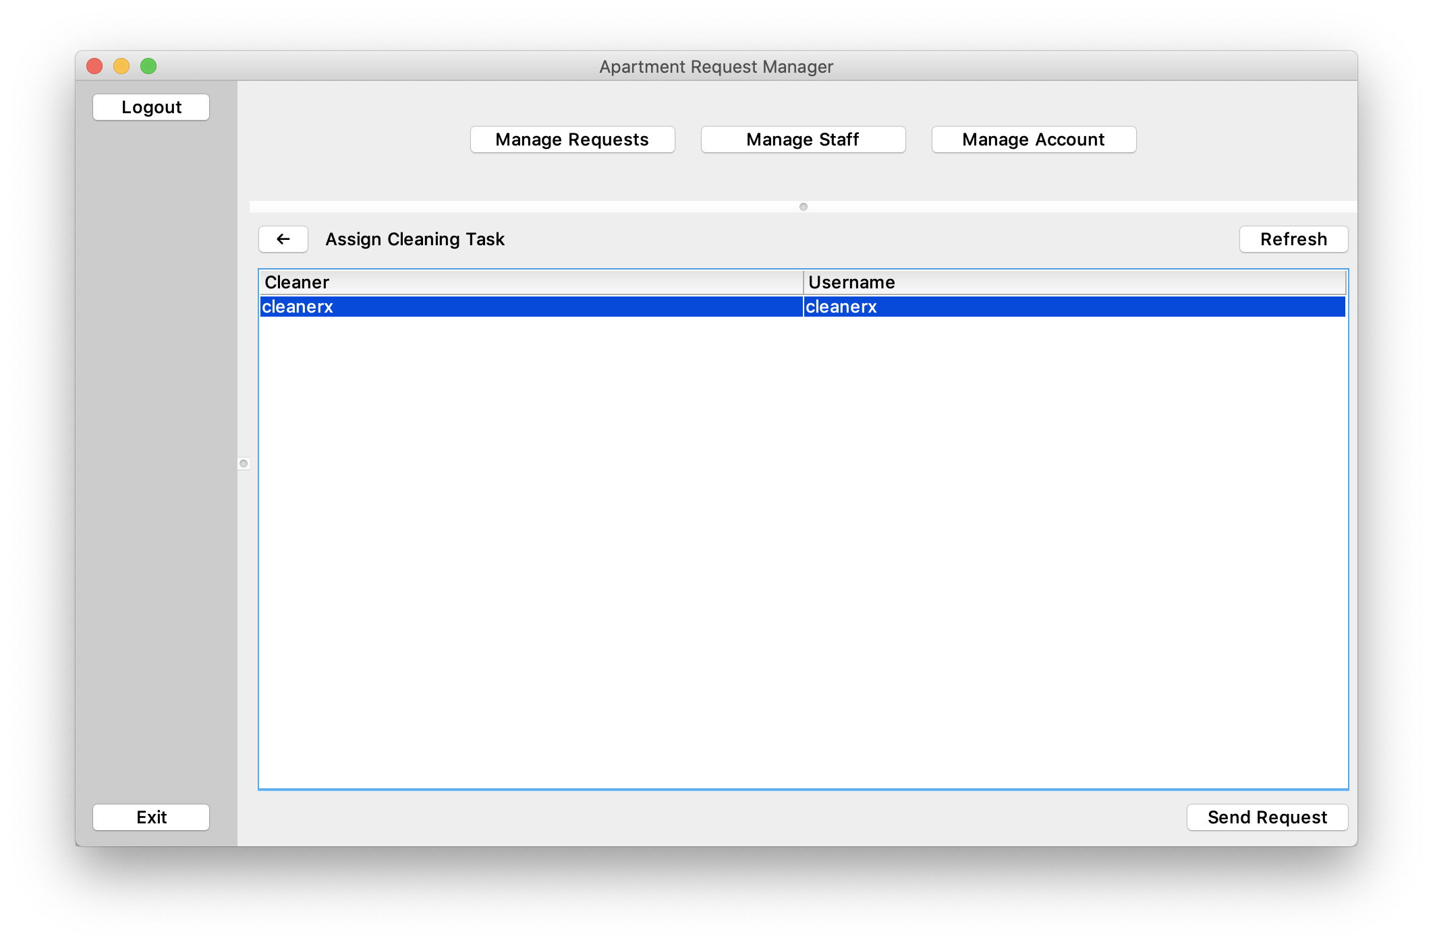
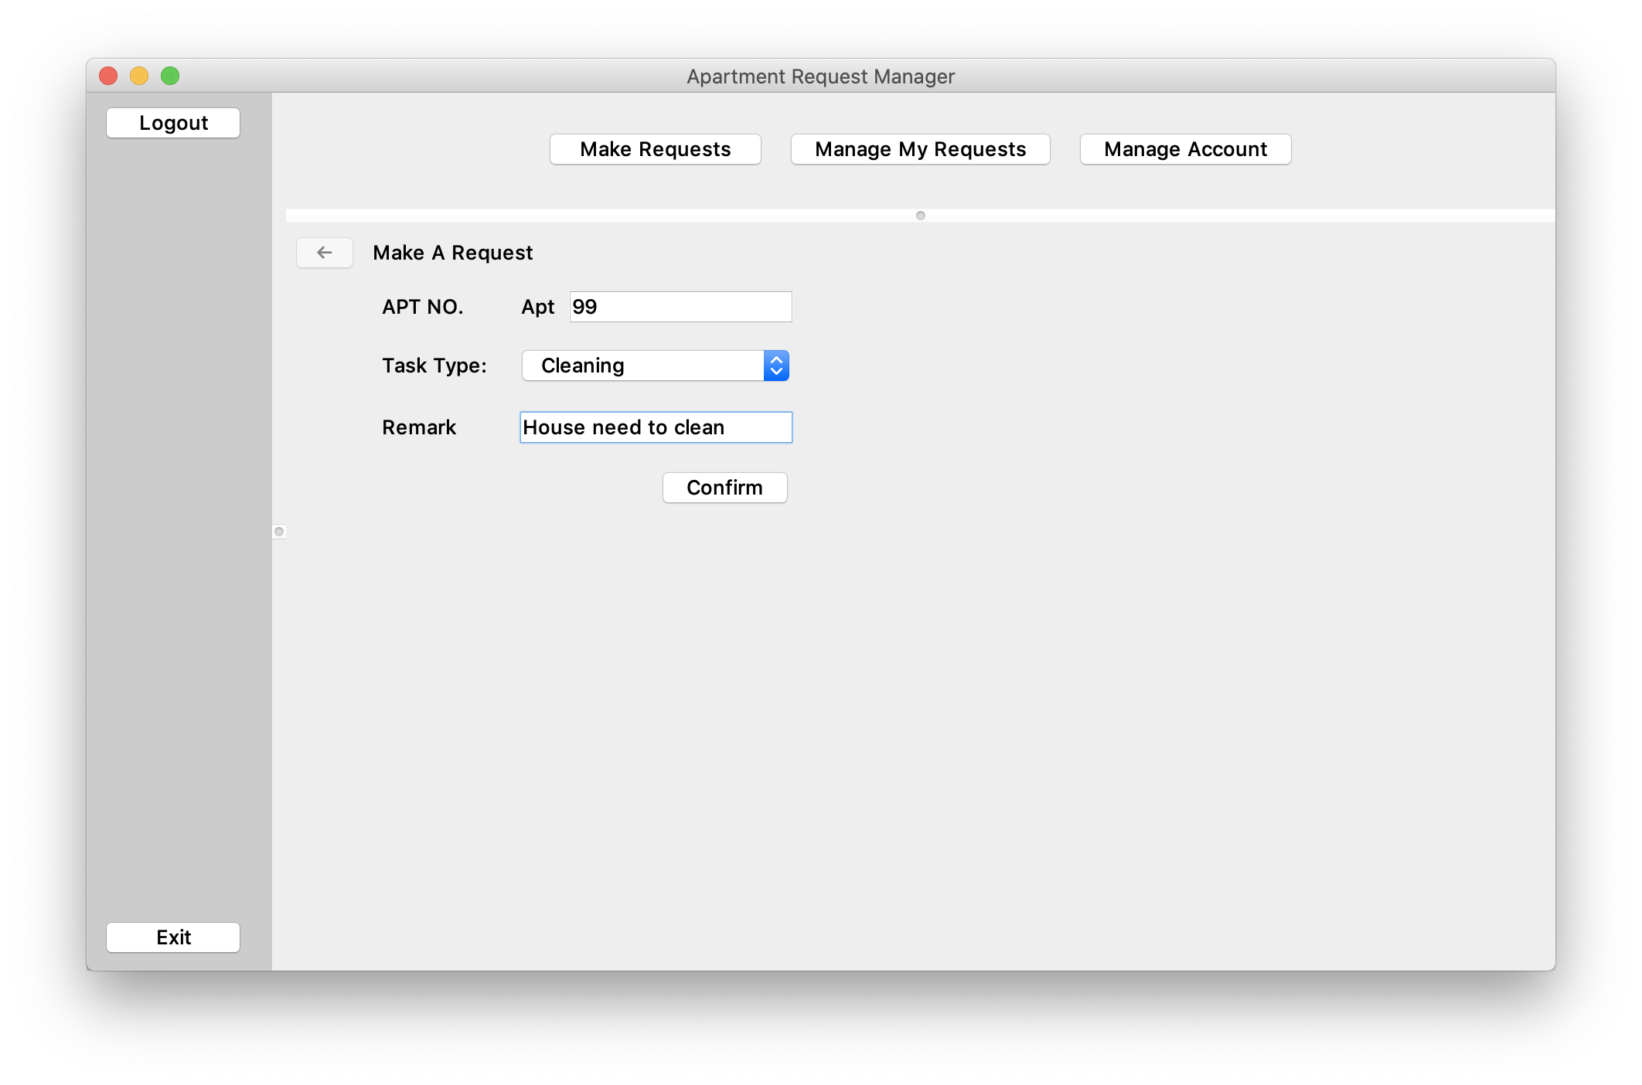
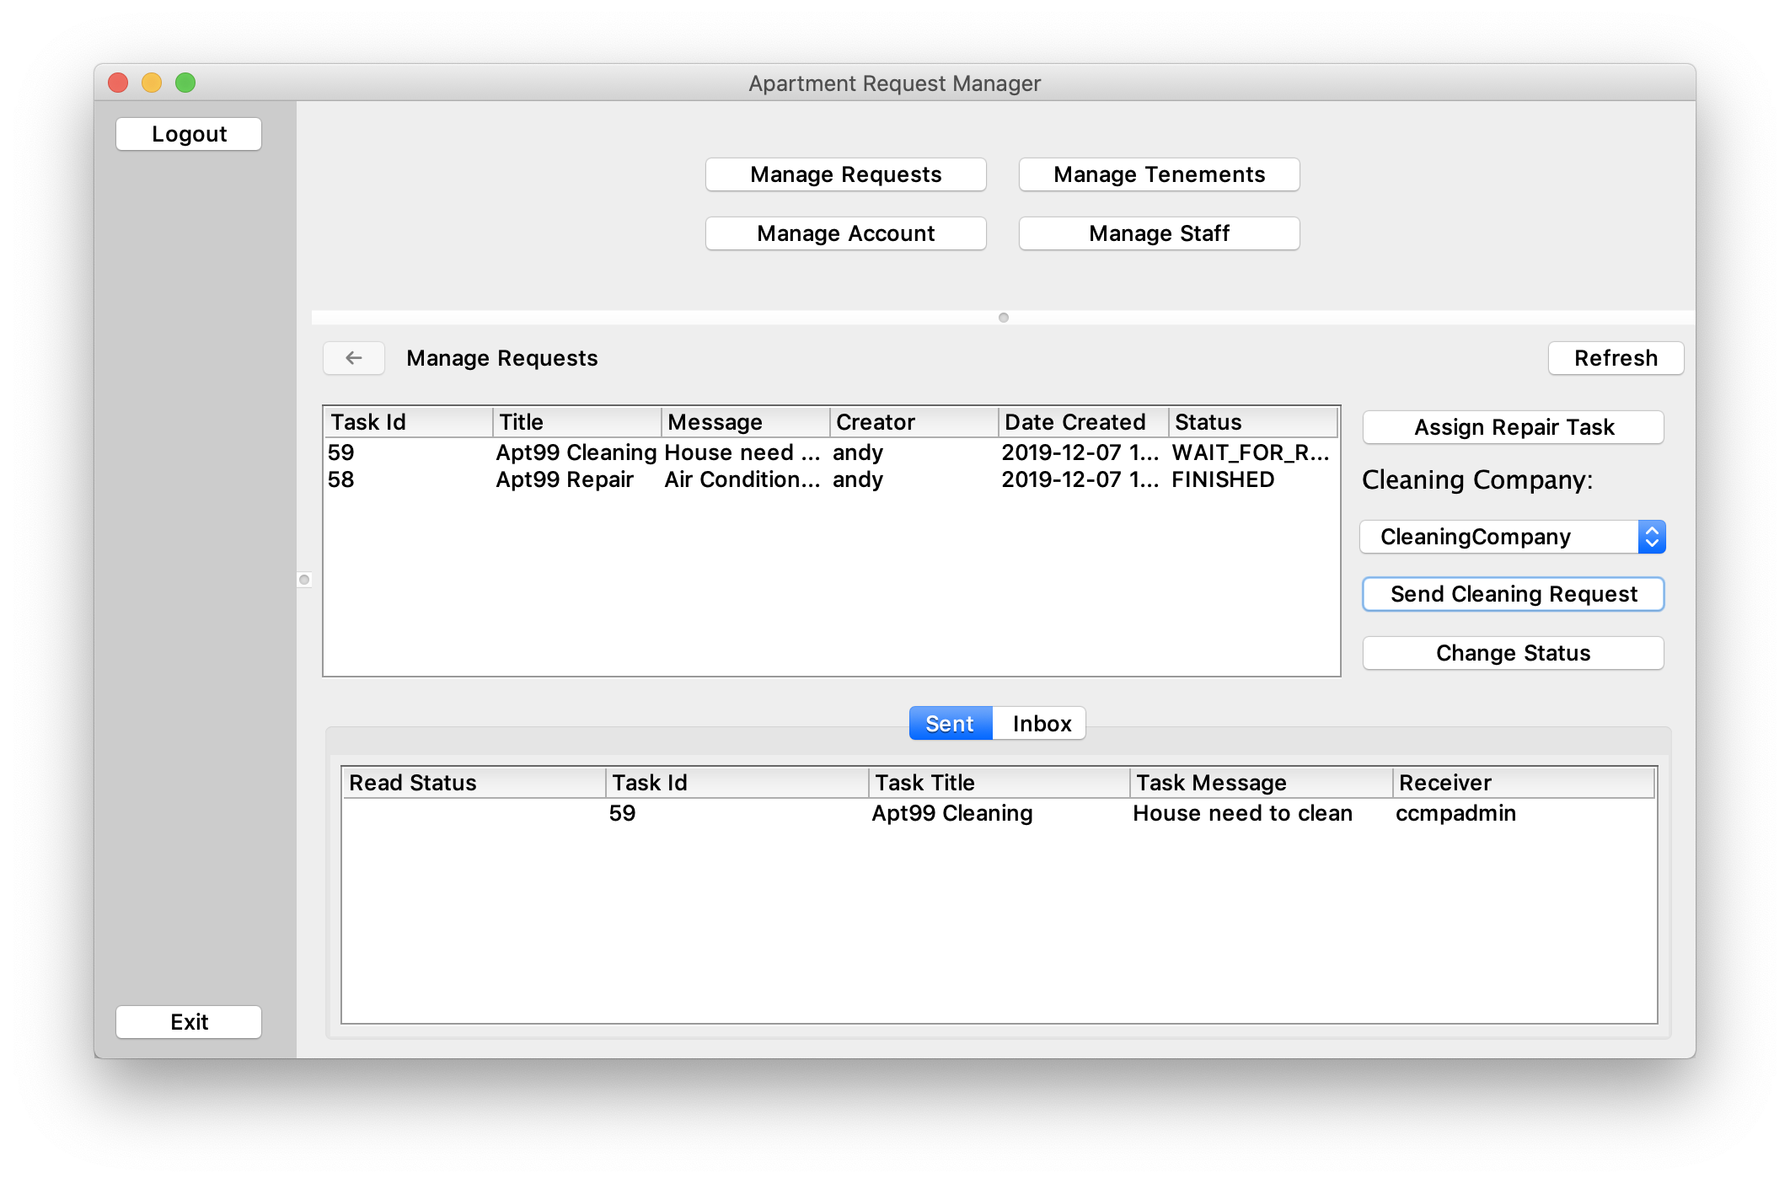
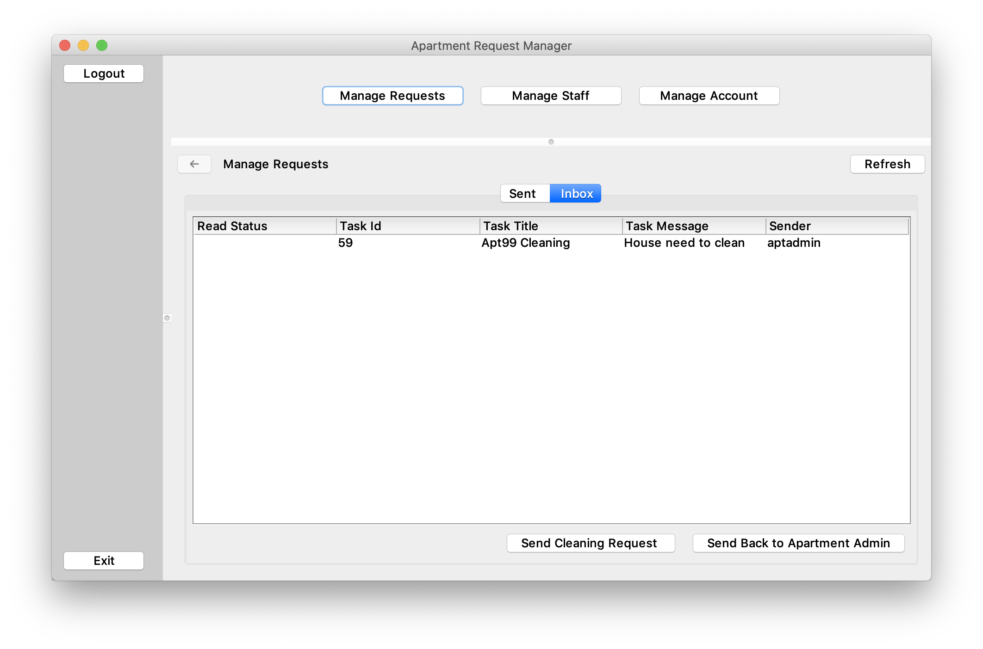
Use Case #Cleaning Request
Company LOGO

Slide 8
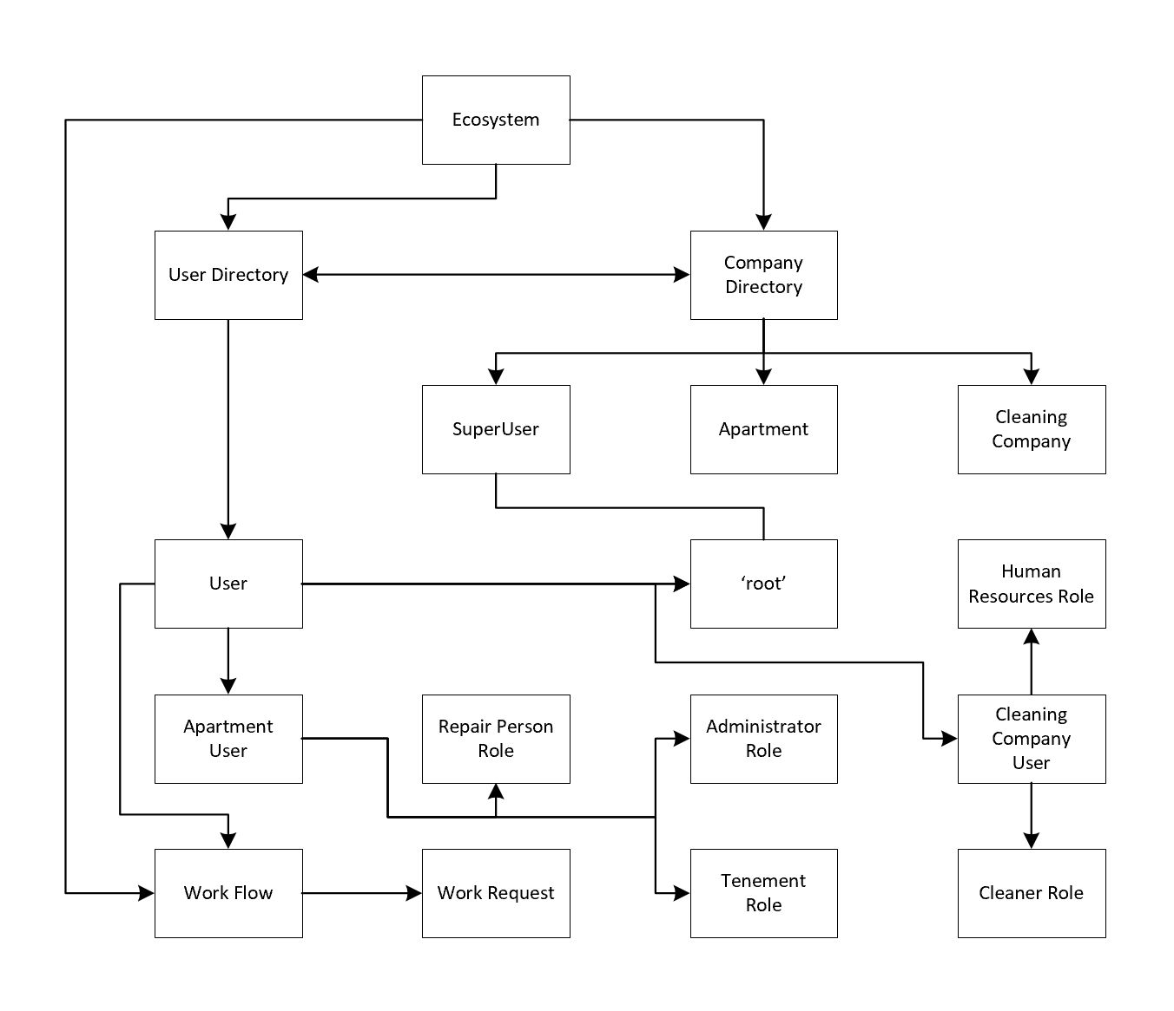
Design
Company LOGO

Slide 9
Work Flow
Company LOGO
Tenement
send requests
Apt Admin
feedback
feedback
complete work
Repair man
send requests
Finish
send requests
Cleaner
Clc Admin
complete work
feedback

Slide 10
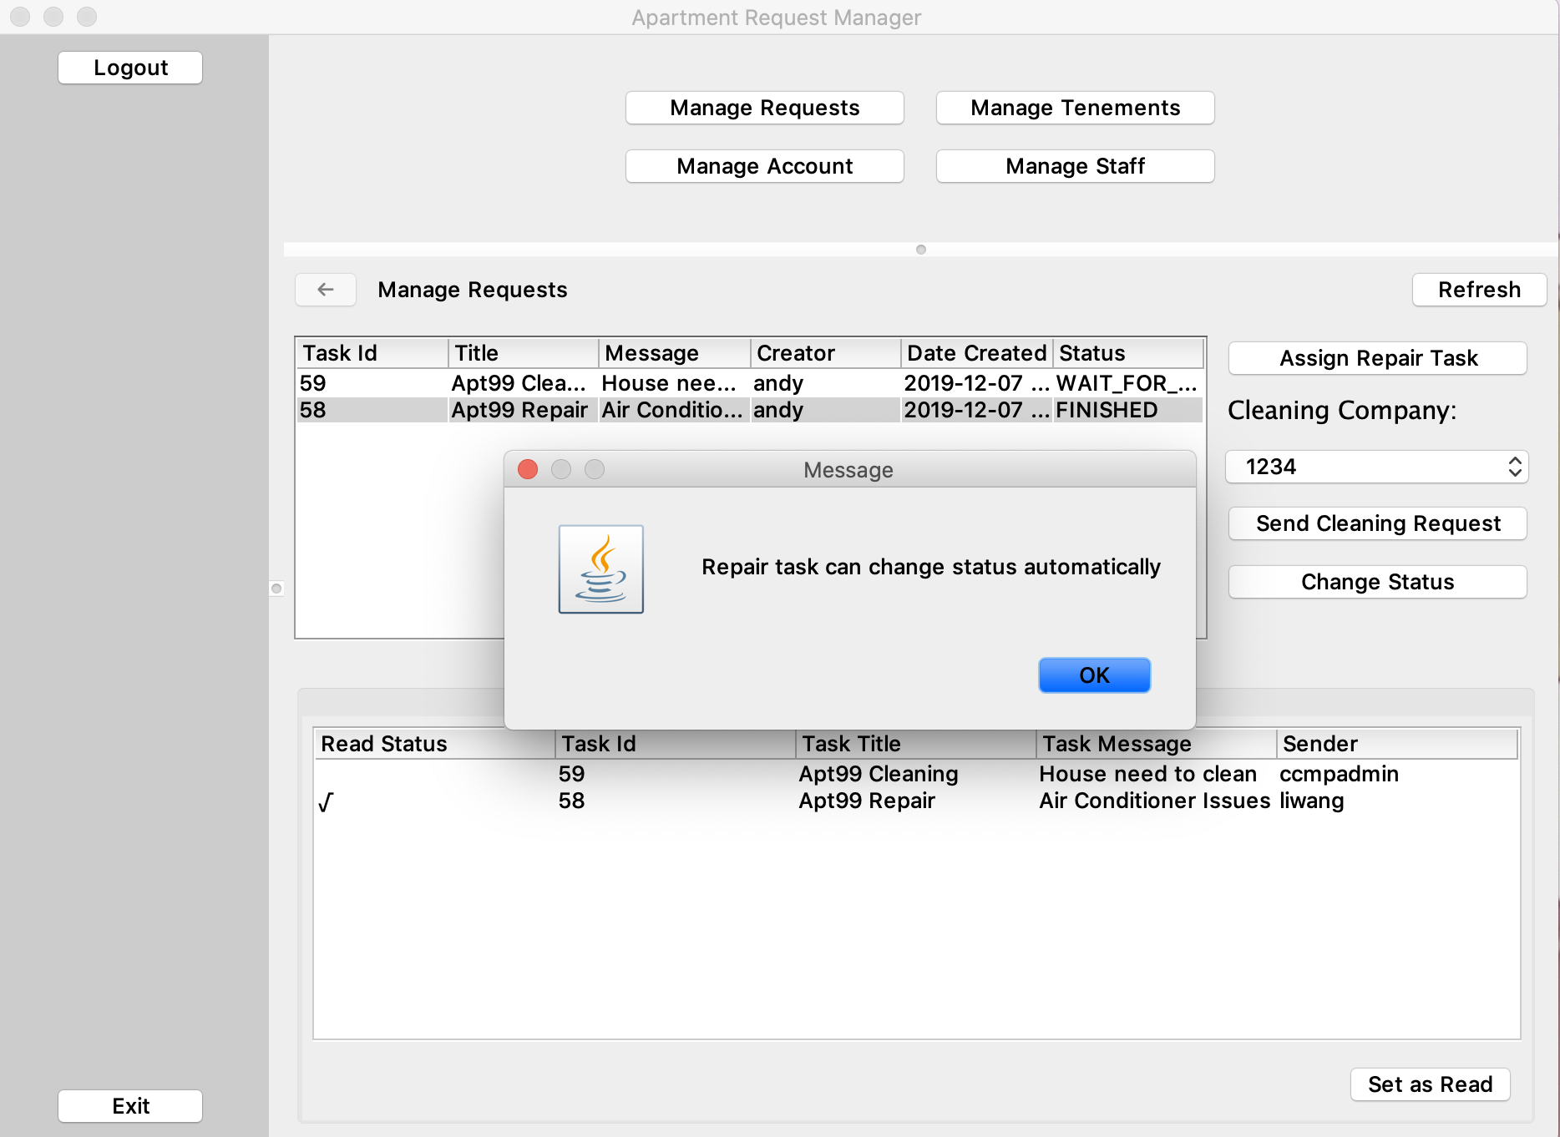
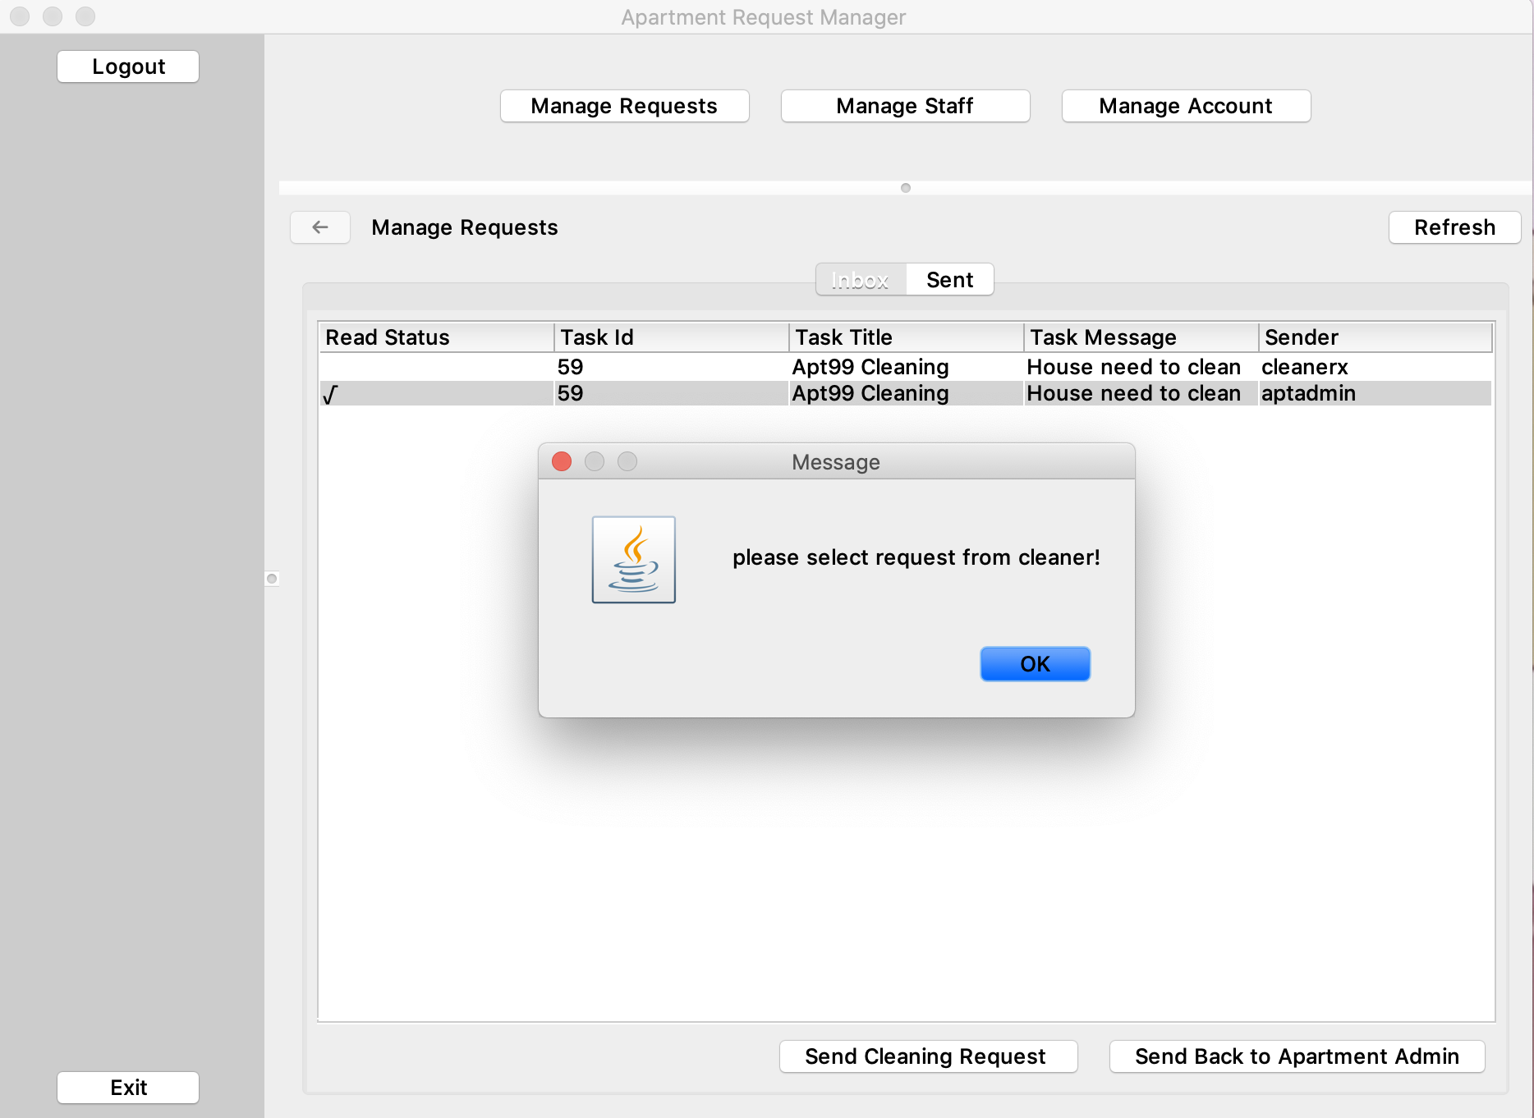
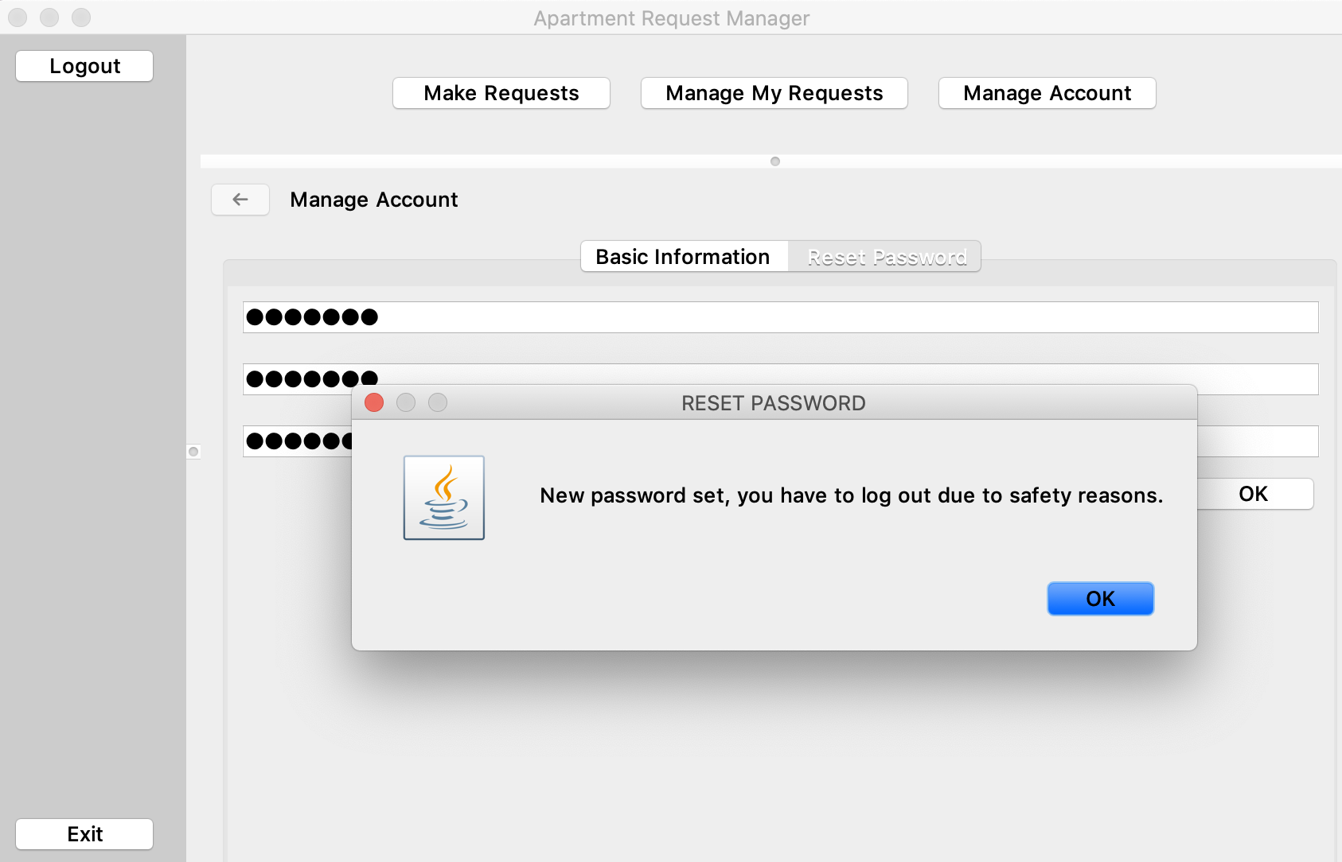
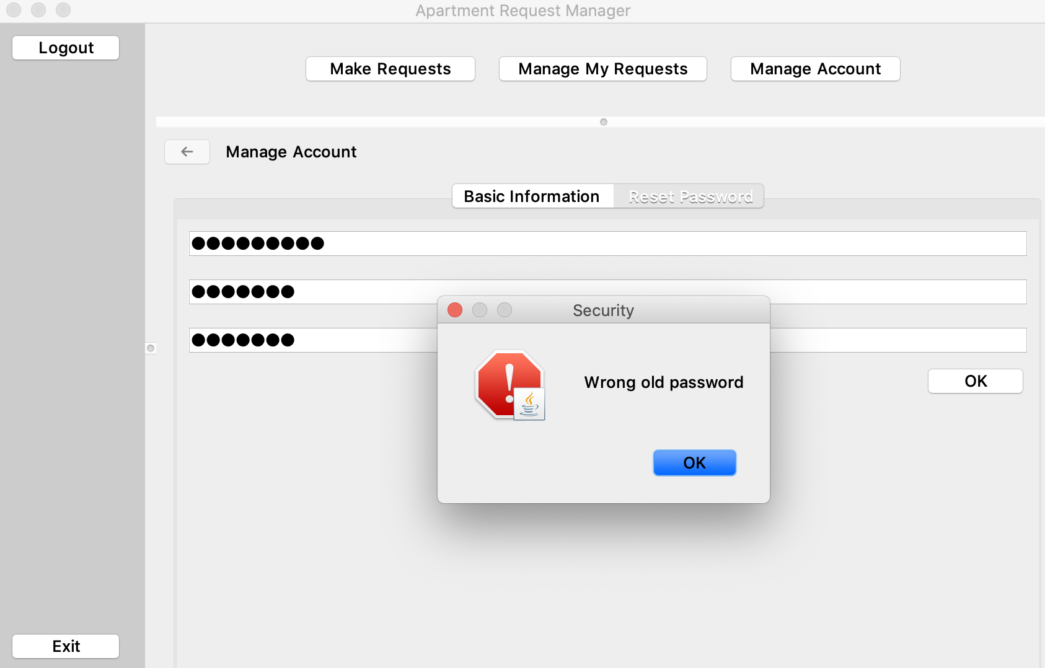
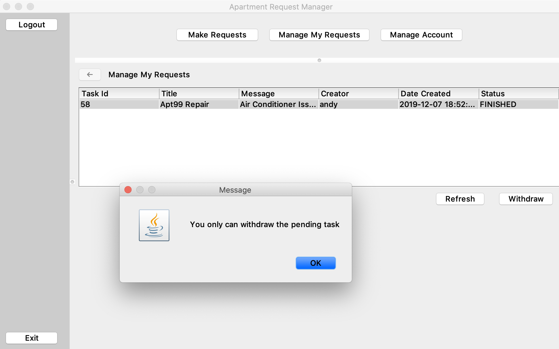
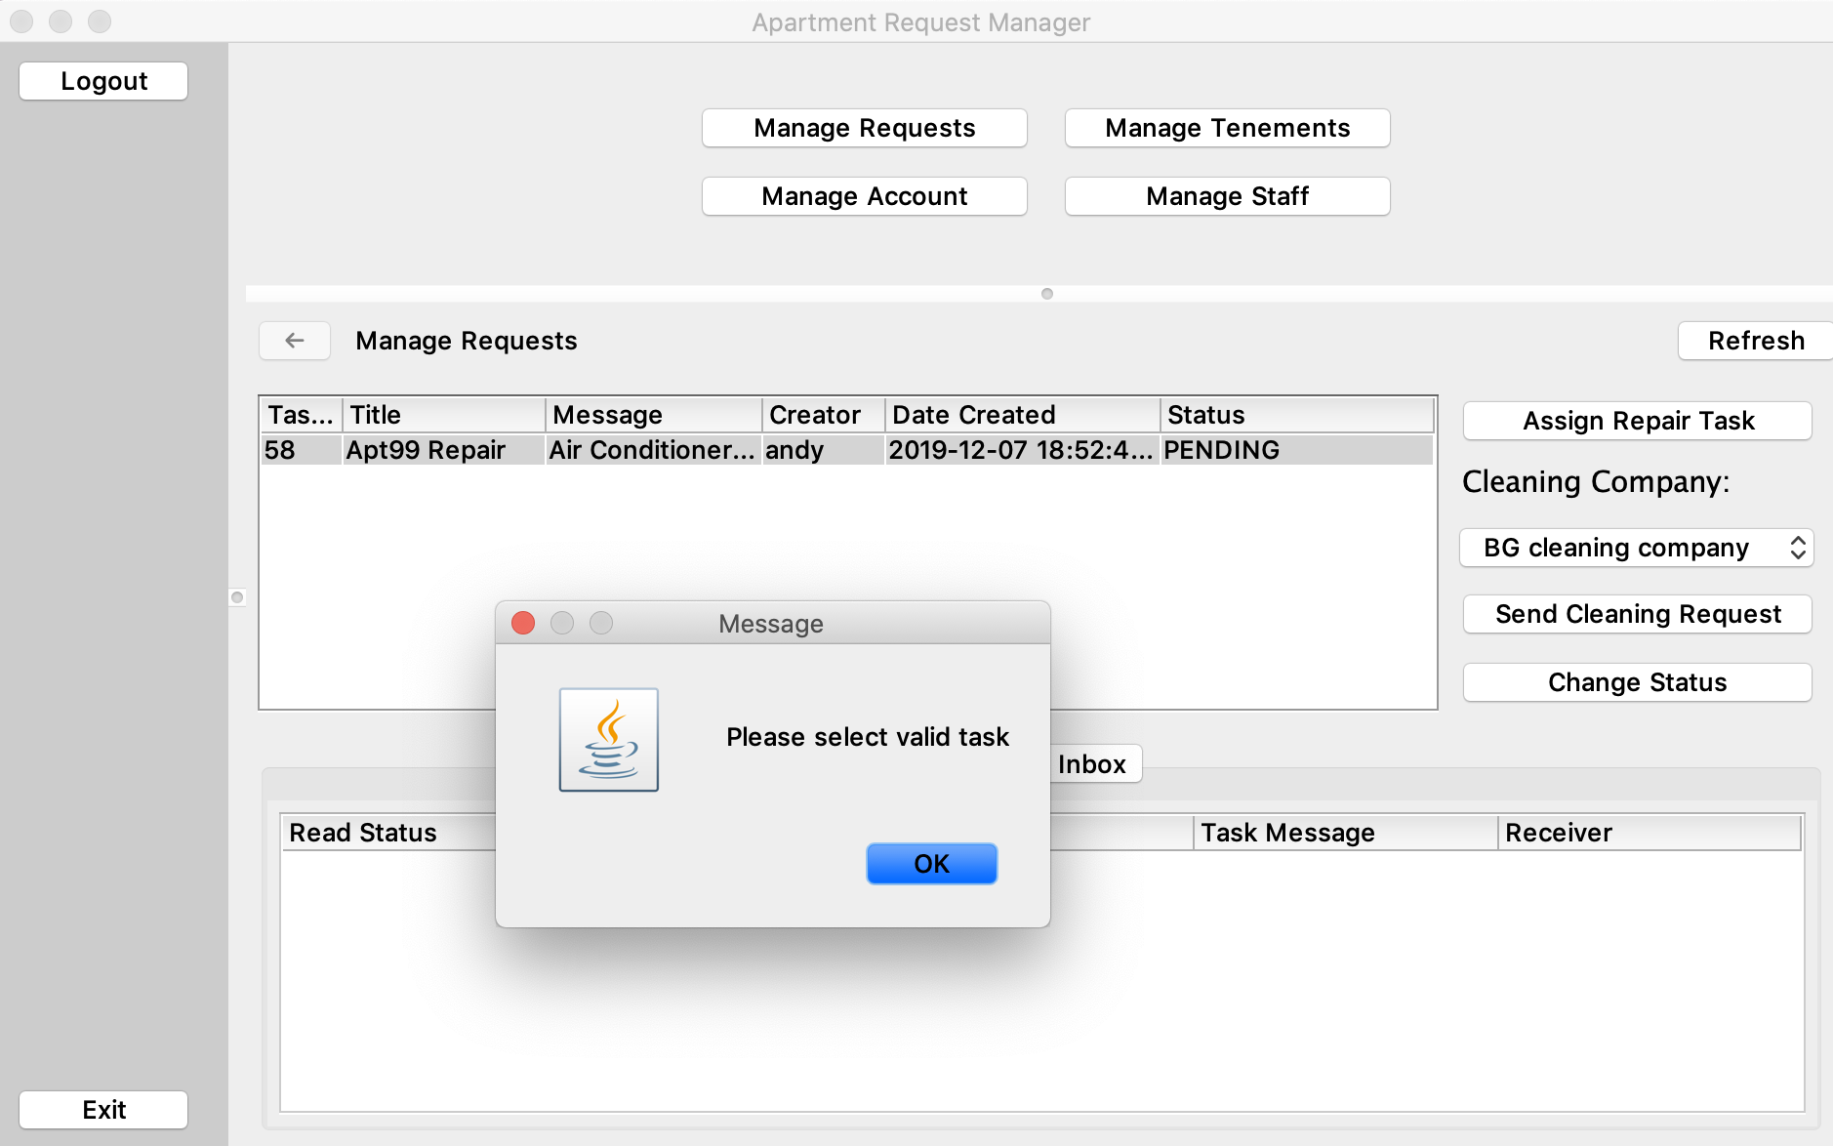
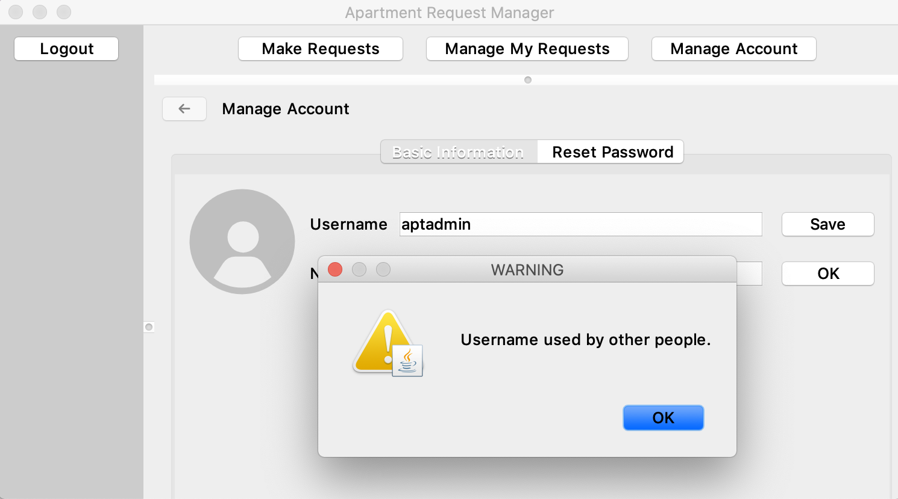
Validation & Logic Part
Company LOGO

Slide 11
The End
Company LOGO
Thanks!

